Slide 1
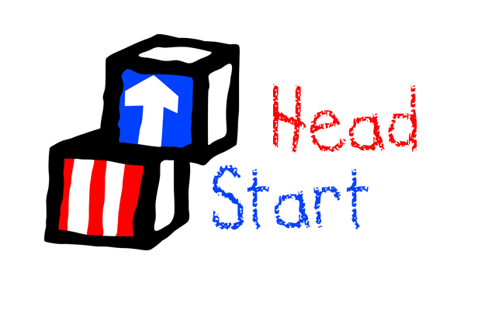
History of Providing Head Start Programming in Baltimore City
Denine Rafus, Catholic Charities Head Start Administrator

Slide 2
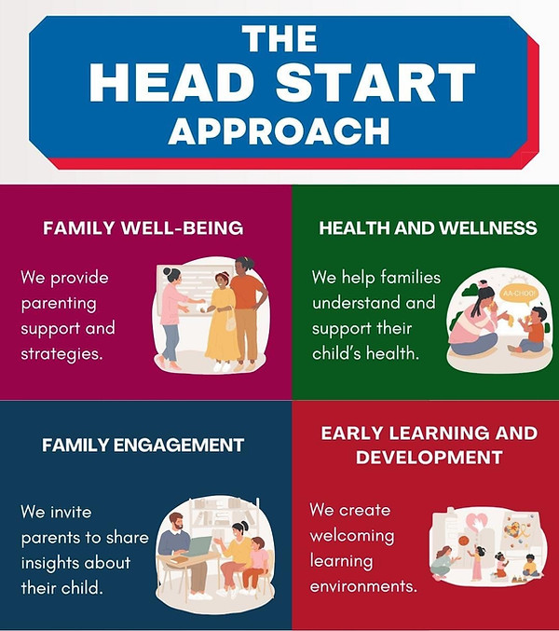
Head Start Launched in 1965
Programming was available in Baltimore City

Slide 3
Catholic Charities
Mayor’s Office
St. Vincent de Paul
Y in Central MD
Maryland Family Network
Restructuring in 2014

Slide 4
Head Start’s Impact
Services to Children
Services to Families
100% of the children received comprehensive services including school readiness, health and mental health, and nutrition services
431 infants and toddlers were served 2,043 3 and 4 year older were served
487,400 meals were served
2,247 Developmental Screenings were conducted
86% of children received follow-up medical/dental care
95% of the children receiving comprehensive services live at or below the federal poverty line
90% of families who requested a service, received that service over the course of the year
82% of families who set a goal achieved or were expected to achieve that goal.
1,225 parents participated in training during the program year.
783 families received holiday support, school supplies, clothing etc.
417 parents volunteered.

Slide 5
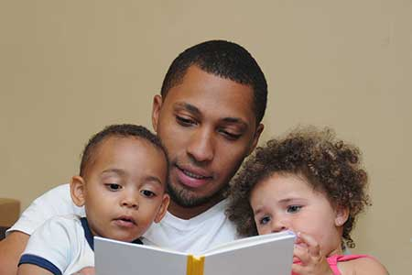
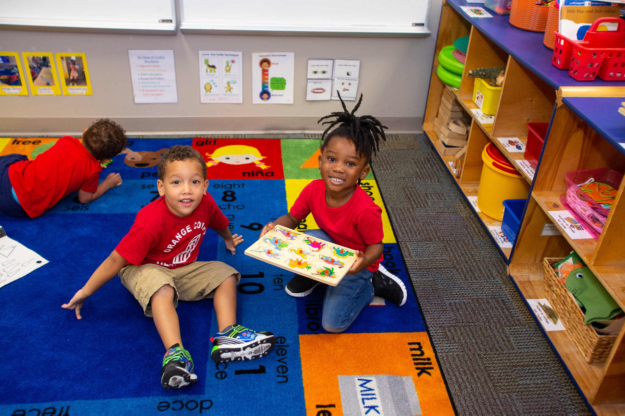
After 60 Years, Head Start Still Works

