Slide 1
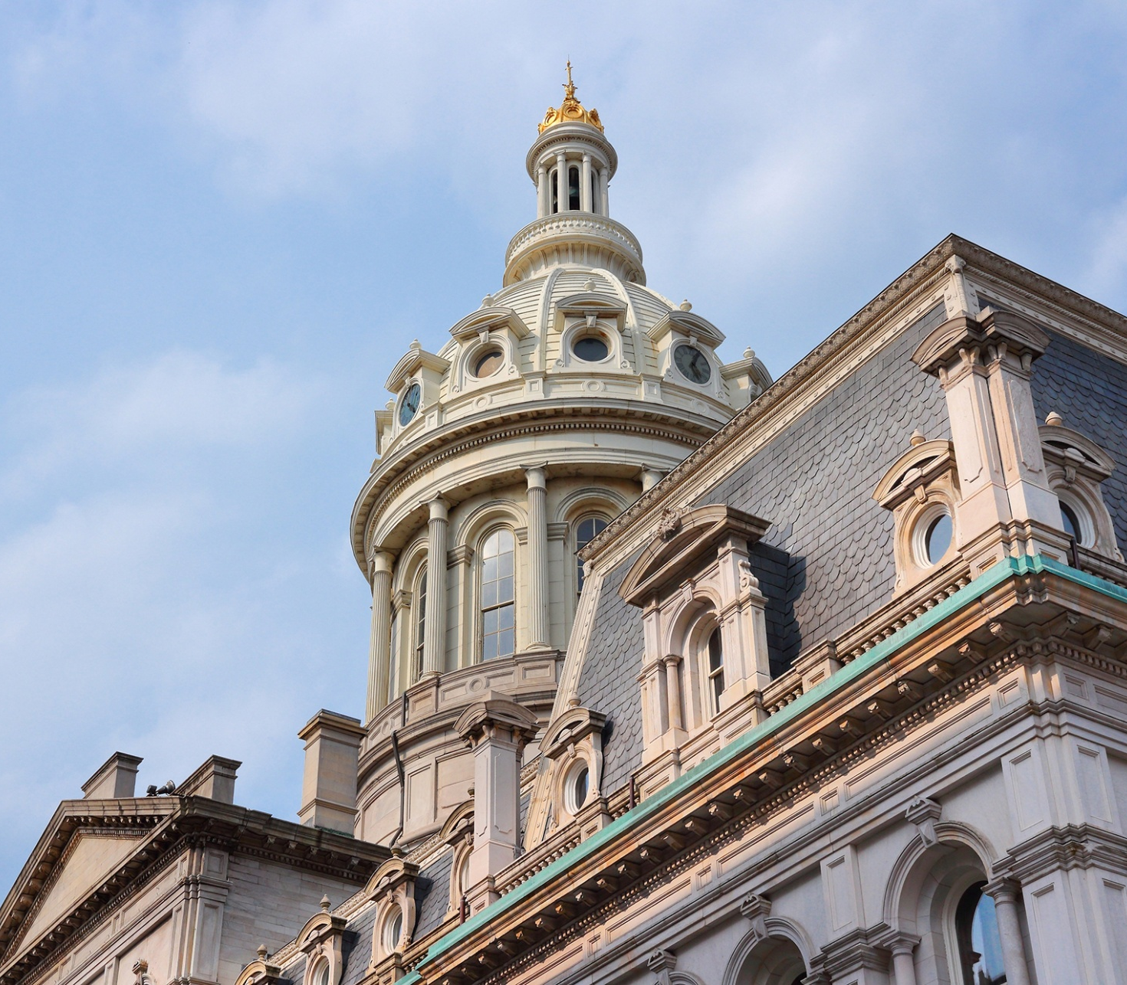
26-0042R
Informational Hearing
July 23, 2026

Slide 2
Table of Contents
Detention Numbers
Safe City Baltimore Overview
Tier 3 progress and findings
New Resources

Slide 3
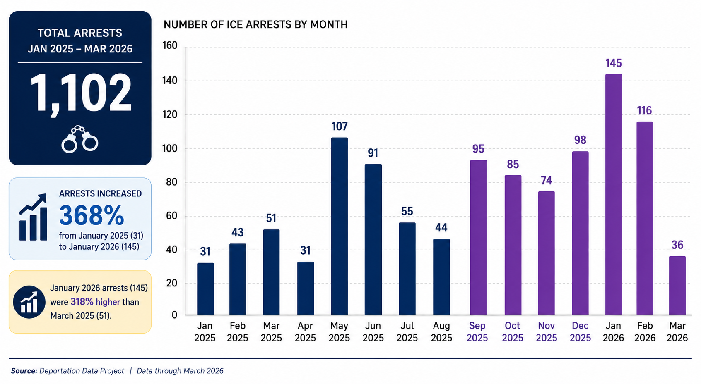
ICE Arrests Over Time
ICE arrests rose sharply in May 2025 and remained elevated through the end of the year and reached a peak in Jan 2026
649 arrests since Sept 2025
March 2026 decline

Slide 4
Safe City Baltimore
Tier I
Community Education & Family Safety Plan Preparation
Tier II
Legal Screenings and Representation for those with feasible claims
Tier III
Deportation Defense for Families Unable to Afford an Attorney and Family Support

Slide 5
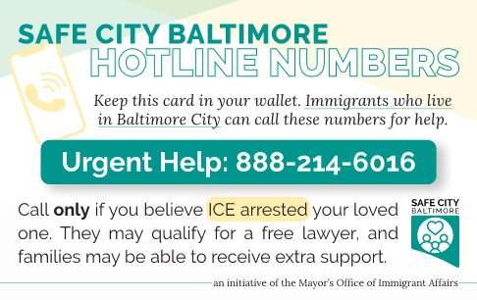
Tier 3: Deportation Defense for Families Unable to Afford an Attorney and Family Support
CASA’s Response:
accept calls through their rapid response hotline (at right) which are referred to CASA Baltimore staff
Share information on the detained individual with Amica.
Case managements & financial assistance for families
Amica Center for Immigrant Rights Detained Defense:
Receives referrals from CASA & other network providers
Provides legal counsel and representation for eligible detained Baltimore City residents

Slide 6
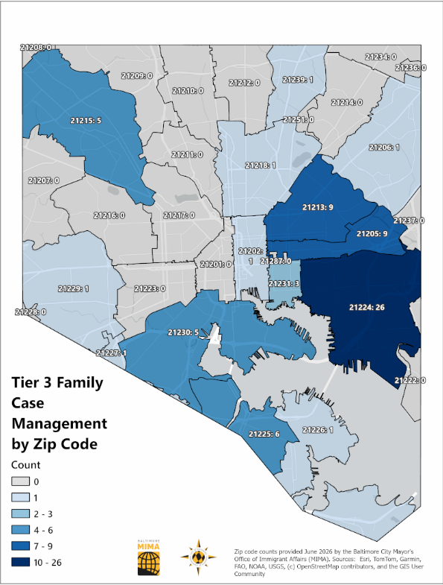
Tier 3: Update
CASA screened 742 calls
143 detained city residents were referred to Amica for legal services
78 households received case management support and financial assistance.
The referral mechanism is effective & efficient: approximately 90% referrals Amica received were from the Safe City partnership.

Slide 7
Tier 3: Case Management Findings
95% of those receiving case management are women vs. 5% men
Average family size: 4
Languages spoken: Spanish and French
Years of residency in Baltimore
  61% of those receiving case management have lived in the City for more than 5 years.

Slide 8
New Resources
Increase case management capacity and financial assistance
Establish behavioral mental supports for families impacted by detention

Slide 9
How to best support impacted immigrants
Direct the immediate family of a detained individual to contact CASA's hotline at 888-214-6016 to ensure a streamlined coordinated response
Encourage families to prepare for immigration emergencies by completing Standby Guardianship forms. Safe City Baltimore supports Maryland Volunteer Lawyer Services (MVLS) to help families complete these forms. Those who need support can call MVLS at 410-547-6537.
Donate to the Baltimore Immigrant Community Fund

Slide 10
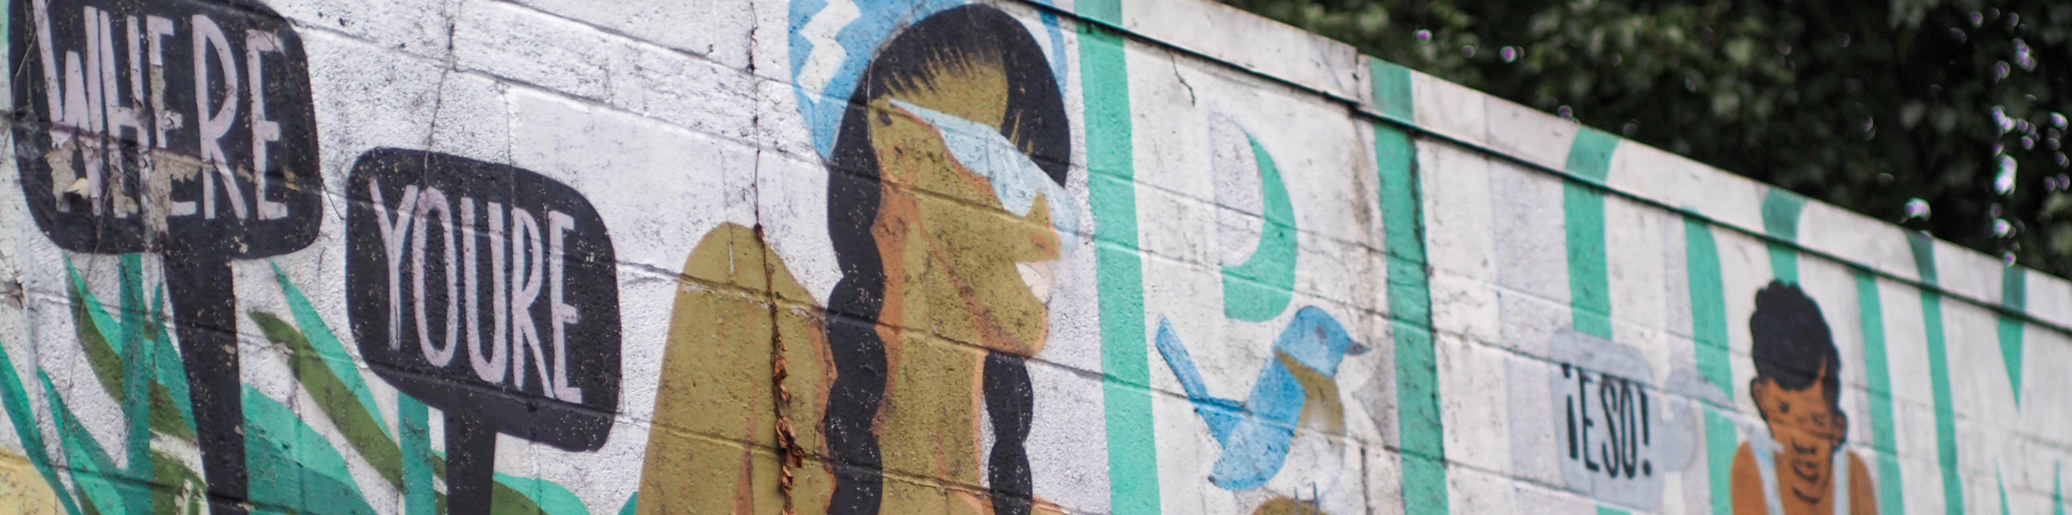
Thank you!
Catalina Rodriguez Lima
catalina.rodriguez-lima@baltimorecity.gov
www.baltimorecity.gov/mima
@mimabaltimore

