Slide 1
Oversight of Recovery Homes and Substance Use Disorder Clinics
in Baltimore City
July 22, 2026
LO25-0024

Slide 2

BHSB’S HISTORY
BMHS, 1986
BSAS, 1990
BHSB, 2013
Robert Wood Johnson grant
Targeted Cities grant
Intentionally created as non-profits
Formed through merger

Slide 3






BHSB’S CORE
FUNCTIONS
Advocacy &
Planning
Local
Partnerships
System
Management
Managing
Public Funds
Public
Education

Slide 4
SUD Programs and Recovery Residences

Slide 5
Substance Use Disorder Clinics
SUD treatment programs require accreditation and licensure
Licenses are based on American Society of Addiction Medicine (ASAM) guidelines
Outpatient programs:
  Outpatient Treatment Level 1.0
  Intensive Outpatient Treatment Level 2.1
  Partial Hospitalization Treatment Level 2.5
Residential programs:
  Residential-Low Intensity Level 3.1
  Residential-Medium Intensity Level 3.3
  Residential-High Intensity Level 3.5
  Residential-Intensive Level 3.7
Specialty licenses:
  Withdrawal Management Service
  Opioid Treatment Service (OTP)

Slide 6
Pause on BH Provider Enrollment Still in Effect
On 7/1/24, MDH issued a pause on newly enrolling provider types:
Psychiatric Rehabilitation Programs (PRPs)
SUD Partial Hospital Programs (PHP)
SUD Intensive Outpatient Treatment Programs (IOP)
MDH extended the pause through 12/31/26 in ten jurisdictions:
  Baltimore City
  Nine other populous Maryland jurisdictions (Balt Co, Anne Arundel, Howard, Harford, Carroll, Frederick, Washington, Montgomery, Prince George’s)

Slide 7
Recovery Residence
Certification from Maryland Certification of Recovery Residences (MCORR)
Certification ensures residences provide safe, healthy, community-orient environments
BHA responsible for certification, oversight, and investigations
To obtain state recovery home funding, the residence must be certified
Currently 46 certified recovery housing programs in Baltimore

Slide 8

Open 24/7, Walk-ins welcome
The Center provides immediate access to stabilization and recovery support services for adults 18+ who need urgent substance use care to recover from the symptoms of acute intoxication from drugs or alcohol.
Services offered include:
  Up to 23-hr observation
  Medical screening & monitoring
  Meals, showers, laundry service, transportation assistance
  Buprenorphine induction
  Peer support & counseling
  Referrals to treatment & recovery services
Notes:
Center has a new name and new operator—CarePoint Response.
The name change is intended to make clear what services offered and that the program serves ppl with SUD as their primary need
Center is located at 710 Dukeland Ave.

Slide 9
COMAR 10.63 Community Behavioral Health Regulation Revisions

Slide 10
COMAR 10.63 Revisions
Intended to address provider accountability and service quality
Establishes new expectations for certain provider types
Provides new tools for system accountability
Adds new requirements for recovery residence certification

Slide 11
Timeline of Activities:
Summer 2024: Unofficial draft of COMAR 10.63 revisions released for stakeholder feedback
May 2025: Official draft regulations published in MD Register (included Chapters 1,2,6,9)
August 2025: MDH rescinds draft regs
Dec 2025 - March 2026: Stakeholder convenings to obtain agreement w/stakeholders​
COMAR Revisions
COMAR 10.63 - Community-Based Behavioral Health Programs and Services

Slide 12
On Friday, July 10, 2026, MDH submitted proposed COMAR 10.63 regulations to the Joint Committee for Administrative, Executive, and Legislative Review (AELR)
All proposed regulations are submitted to the AELR Committee for review at least 15 days before they are submitted to the Maryland Register for publication
MDH may adopt a proposed regulation 45 days after the regulation is published in the Maryland Register. Thirty of the 45 days must be reserved as a public comment period.
COMAR Revisions
COMAR 10.63 - Community-Based Behavioral Health Programs and Services

Slide 13
Provider Accountability

Slide 14
BHSB provides leadership, management, oversight, and operations functions at the local level in collaboration with the BHA and the Medicaid Administrative Services Organization (ASO).
Link: Manual for Managing the PBHS in Maryland
BHSB Accountability Functions:
Conducting regular audits and site visits
Approving and monitoring Corrective Action Plans, Performance Improvement Plans, and Program Improvement Plans
Complaints protocols, resolutions, and tracking
Investigation and Tracking of Critical Incidents – suspected abuse/neglect, staff misconduct, suspected fraudulent practices, overdose, death of a participant, etc.
Provider
Accountability
Monitoring for quality and outcomes

Slide 15
Provider Relations
BHSB proactively engages provider network around best practices, responding to community needs, adapting to system changes, and advocating for the PBHS
Quarterly provider convenings
Monthly provider updates
Focus groups on key issues
Site visits with new providers
Resource information sharing
Provider-relations@bhsbaltimore.org

Slide 16
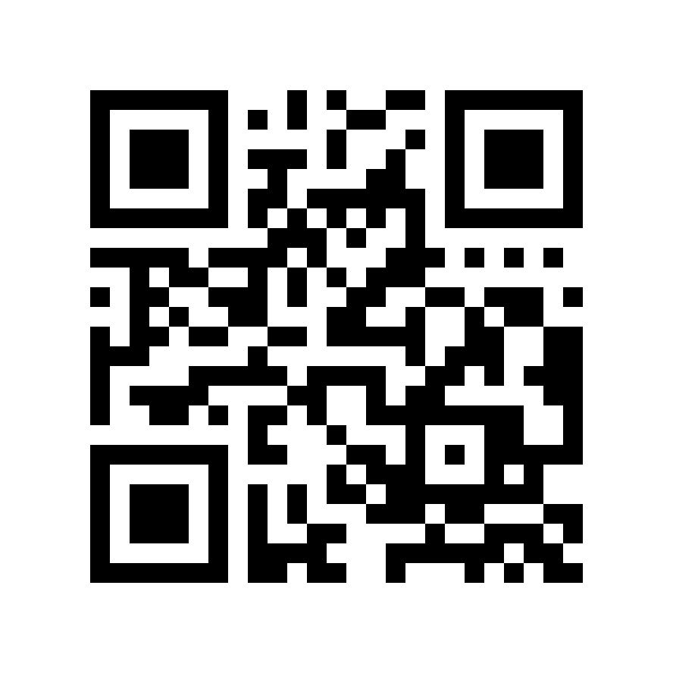
Q: Who can submit a complaint about a provider to BHSB?
A: Anyone can submit a complaint about a behavioral health provider or BHSB to the BHSB Investigations Team. Use the QR code to the left to access the complaint form and process, or visit: File a complaint about a provider or BHSB.
Q: How else can I submit a complaint about a provider to BHSB?
A: You may email: complaints@bhsbaltimore.org, or call 410-637-1900, option 5.
Q: What happens after I report an issue to BHSB?
A: BHSB’s Investigations Team will follow up with the complainant within 2 business days to gather additional information.
The team will then conduct a thorough investigation of the complaint received. Complaints are typically resolved within 30 days if they do not require additional involvement from state agencies.
Provider Complaints

Slide 17
Adrienne Breidenstine
Vice President, Policy & Communications
Adrienne.Breidenstine@bhsbaltimore.org
Dan Rabbitt
Director, Policy
Daniel.Rabbitt@bhsbaltimore.org

