Slide 1

Baltimore's Early Learning Landscape
Progress, Gaps, and What Baltimore Needs Next
City Council Hearing on Early Learning • March 19, 2026
Brain development
happens 0–5
Workforce
behind the workforce
Prenatal-to-five
system

Slide 2
Who We Are
Siyana Partners
The Y Early Childhood Development Center
MSDE
Live Baltimore
BCPS
Cherry Hill Initiative
Maryland State Child Care Association
Kennedy Krieger
Catholic Charities Head Start
Maryland Family Network – Head Start
Downtown Baltimore Child Care
Baltimore City Child Care Coalition
Improving Education
Family League
Sherman Family Foundation
University of Maryland Baltimore County, Child Development Lab
The Richman Foundation
Maryland Family Network
St. Vincent Head Start
Enoch Pratt
BERC – JHU
Strategic Thinking for Social Change
United Way
BCCCRC
Port Discovery
Maryland State Family Child Care Association (MSFCCA)
The Fund for Educational Excellence
Behavioral Health System Baltimore
BC Head Start
Sonja's Sunrise till Sunset Child Care Center
MOCFS
Lakeland Judy Center
Baltimore City Infants and Toddlers
Baltimore City Child Care Resource Center
The Y Head Start
Joshua’s Place Early Learning Center

Slide 3
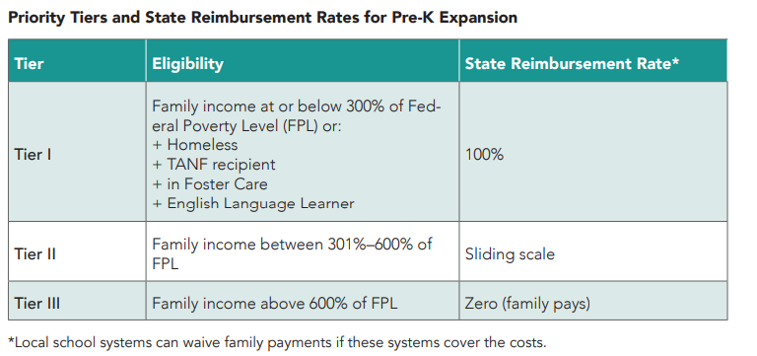
THE LANDSCAPE
Blueprint for Maryland’s Future
Maryland's landmark education law requires expanding Pre-K via a mixed delivery system: public schools AND community-based providers.

Slide 4
THE LANDSCAPE
Baltimore Has Built Real Momentum
4,686
~98%
+100%
Publicly Funded Pre-K seats in Baltimore City
Tier I four-year-olds
with Pre-K capacity
Growth in community-based
mixed delivery providers
since 2022 (6 → 12)
Blueprint for Maryland's Future
Maryland's landmark education law requires expanding Pre-K via a mixed delivery system: public schools AND community-based providers.

Slide 5
THE LANDSCAPE
The Gaps Are Real and Urgent
Not a Universal Pre-K System
1
We can serve 98% of eligible 4-year-olds, but only 65% of all 4-year-olds.
Coverage for Tier I 3-year-olds = Less than 10%.
The Blueprint requires us to reach both.
Mixed delivery far behind target
2
Community-based providers = 8% of Pre-K seats. Blueprint requires 20% by this school year and 50% by 2028–29. No Maryland jurisdiction is on track.
600–800 kids enter Kindergarten with no prior early learning
3
As families struggle to find care, over 800 children enter kindergarten each year with no formal Pre-K experience and it shows in K-readiness data.

Slide 6
THE CORE CHALLENGE
Mixed Delivery Is Both the Strategy
and the Bottleneck
What Mixed Delivery Is
The Barrier
Pre-K is not only in public schools and it was never designed to be.
Community-based providers are child care centers, Head Start programs, family child care homes.
A mixed-delivery system allows families to choose a Pre-K setting that best meets their family’s and their child’s needs.
To participate in publicly funded Pre-K, community-based providers must:
Be a licensed child care program or a federally funded Head Start program
Achieve EXCELS quality rating 3 or above
Meet credential requirements
Pay teachers at parity with public school teachers
…without equivalent stable public funding. Many can't afford to participate, even when they want to.
The result: families are asked to access a system that doesn't yet exist at the scale we need. When licensed care is unaffordable or unavailable, families choose unlicensed care and school readiness data shows the impact.

Slide 7
Looking At Solutions
Three Recommendations
01
02
03
Expand Child Care Scholarships
Create a Mixed Delivery Funding Working Group
Ensure Adequate and Equitable Funding
Explore a local scholarship or subsidy modeled on Montgomery County's EquiCare and Working Parents Assistance programs. Closing the copay gap for families is a prerequisite for closing the enrollment gap.
Baltimore needs a sustained financing strategy for mixed delivery not just annual grant cycles that solely rely on state funding. Convene community-based providers, City Schools, and state partners to answer: Is our commitment to Pre-K truly universal?
Funding must flow equitably to all settings, public schools and community-based providers alike. This requires local investment and state-level advocacy, especially as freeze on the Child Care Scholarship Program has no end date.

Slide 8
AS YOU LISTEN TO TODAY'S PANELISTS HOLD THESE QUESTIONS:
How does this affect ALL Baltimore families?
1
Key Data at a Glance
• 4,686 total public Pre-K seats
• 8% from community-based providers
(goal: 20%)
What would it take for every child in this city to arrive at kindergarten ready to learn?
2
• 800+ kids enter K with no prior
early learning
• 43% K-ready from early learning settings
What is Baltimore City's role in making that happen and what is it willing to fund?
• 17% K-ready from home/informal care
3
Early learning pays dividends for generations. The time to invest is now.

