Slide 1


Slide 2
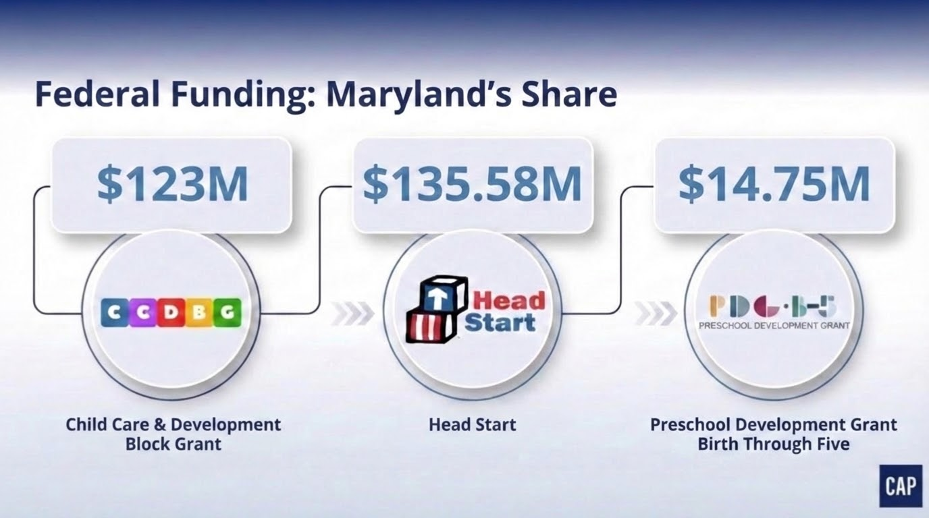

Slide 3
Recent & Upcoming Administrative Actions
01
Allegations of fraud in CCDBG
Funding freezes & “Defend the Spend” mandates
New proposed federal regulations
Child Care
02
Proposed elimination in last year’s federal budget proposals
Forthcoming regulatory changes
Head Start
03
Significantly reduced federal support for programs like Medicaid and SNAP, forcing states to cover more costs or cut services
Impacts state budgets
One Big Beautiful Bill Act

Slide 4
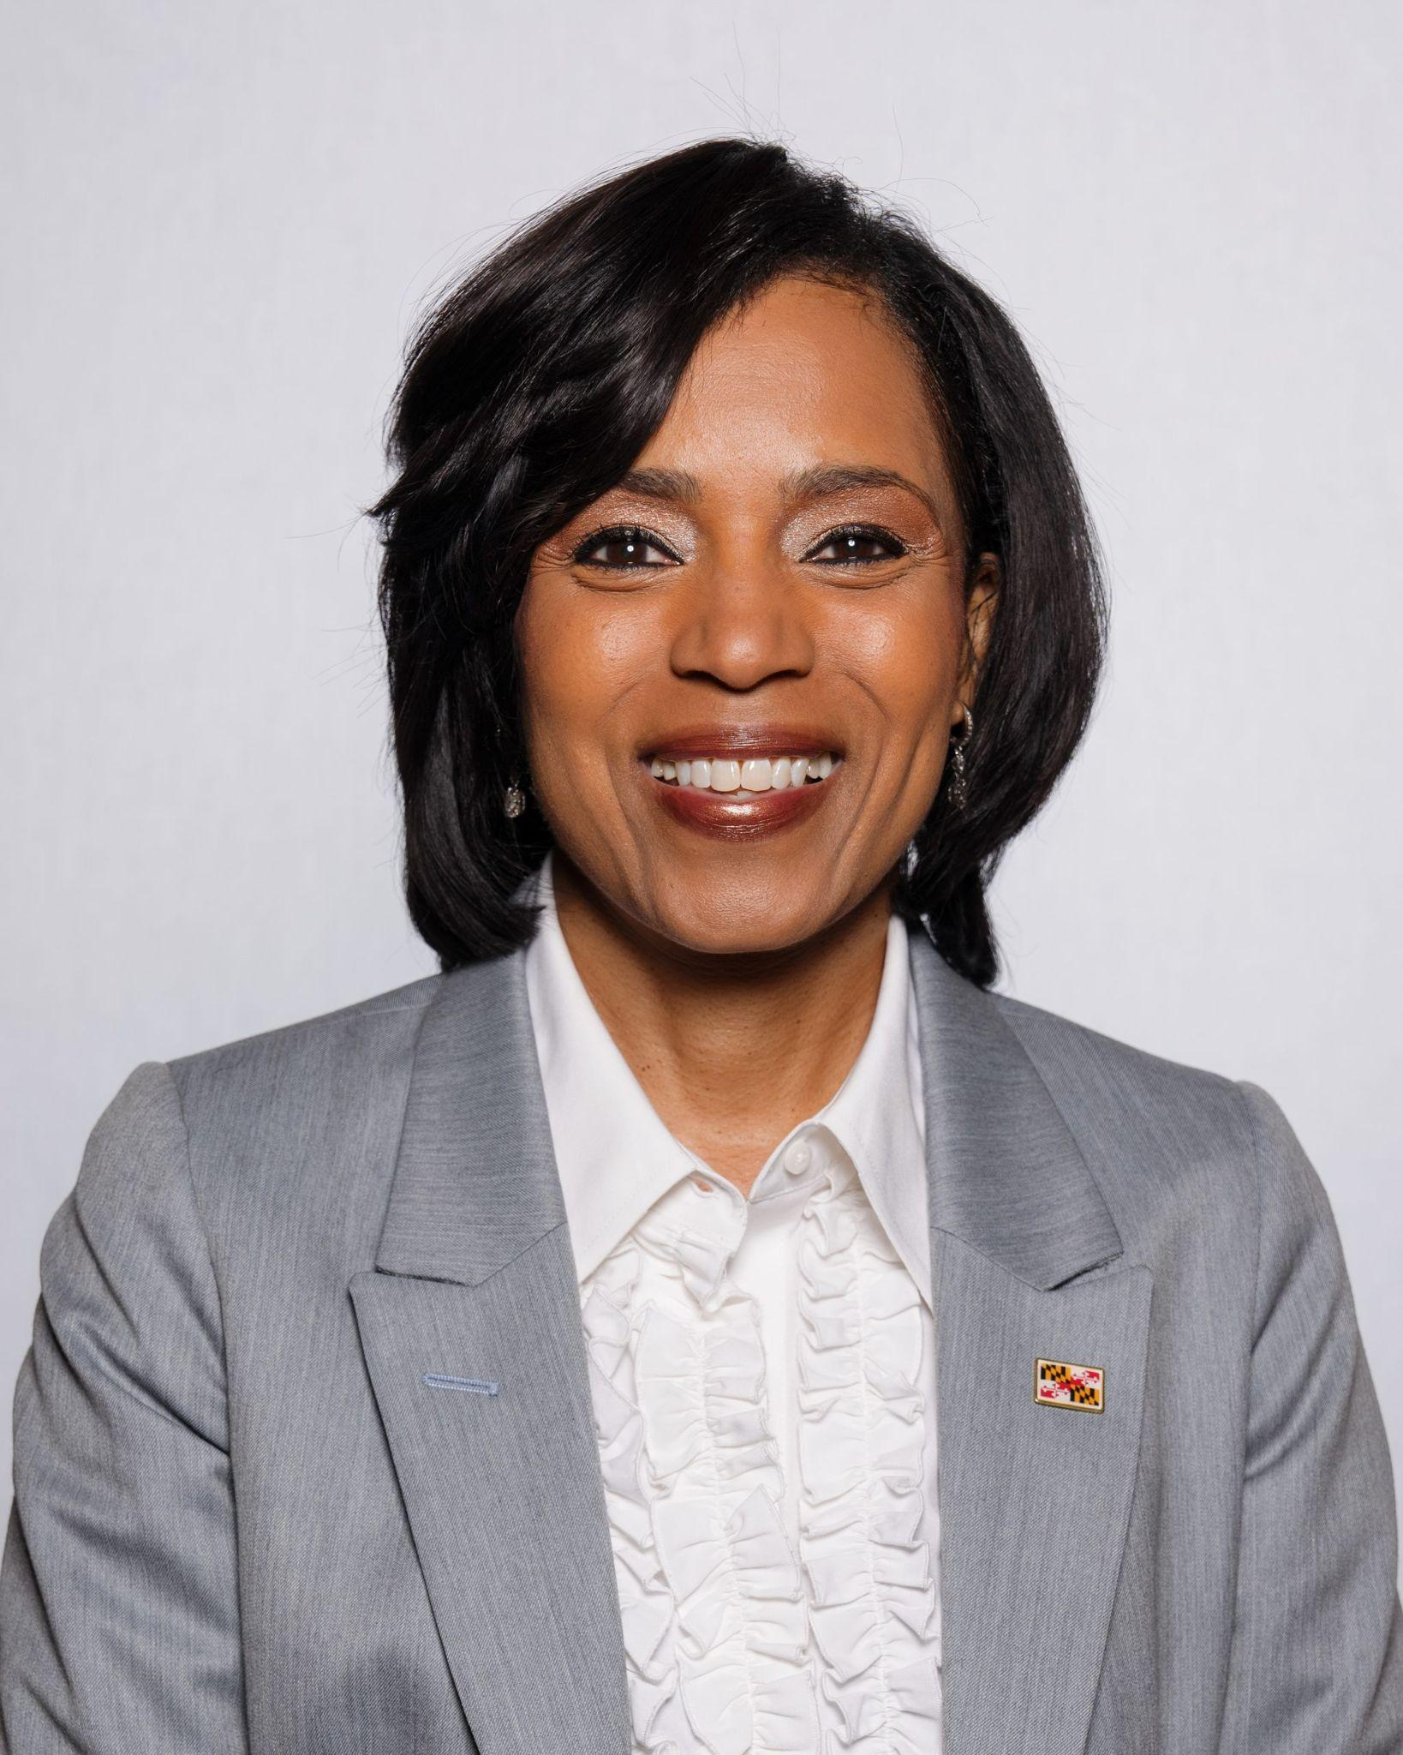
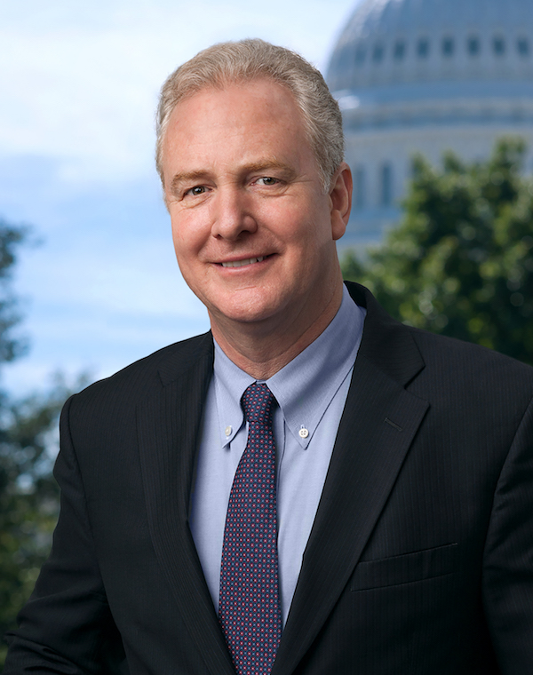
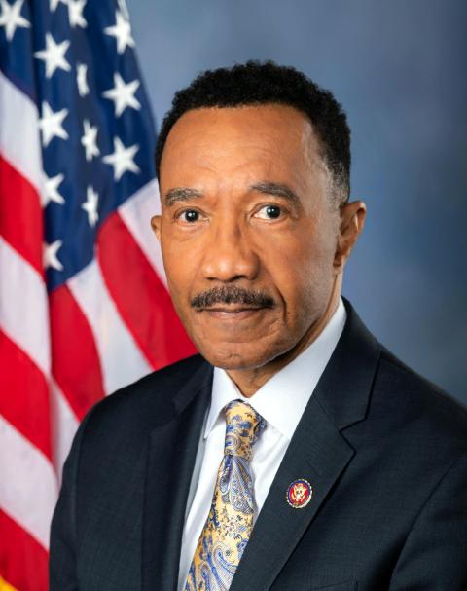
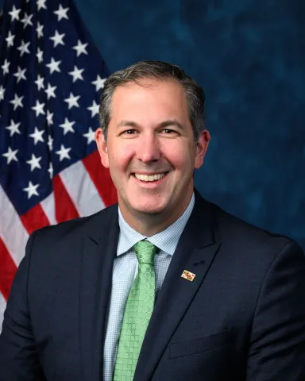
Congressional Delegation & Relevant Committees of Jurisdiction
Sen. Angela Alsobrooks
Senate Health, Education, Labor and Pensions Committee
Sen. Chris Van Hollen
Senate Appropriations Committee
Rep. Kweisi Mfume (MD-07)
House Oversight & Government Reform Committee
Congressman Johnny Olszewski (MD-02)
House Small Business Committee

Slide 5


Mixed-Delivery Best Practices
Offers Pre-K in four unique settings: Boston Public Schools, Community-Based Organizations, Independent Schools, and Family Child Care
By 2030 will provide free preschool for all children ages 3 and 4 in public schools, Head Start, center-based and home-based child care programs
Notes:
Scenario Planning, scenario planning

Slide 6


