Slide 1
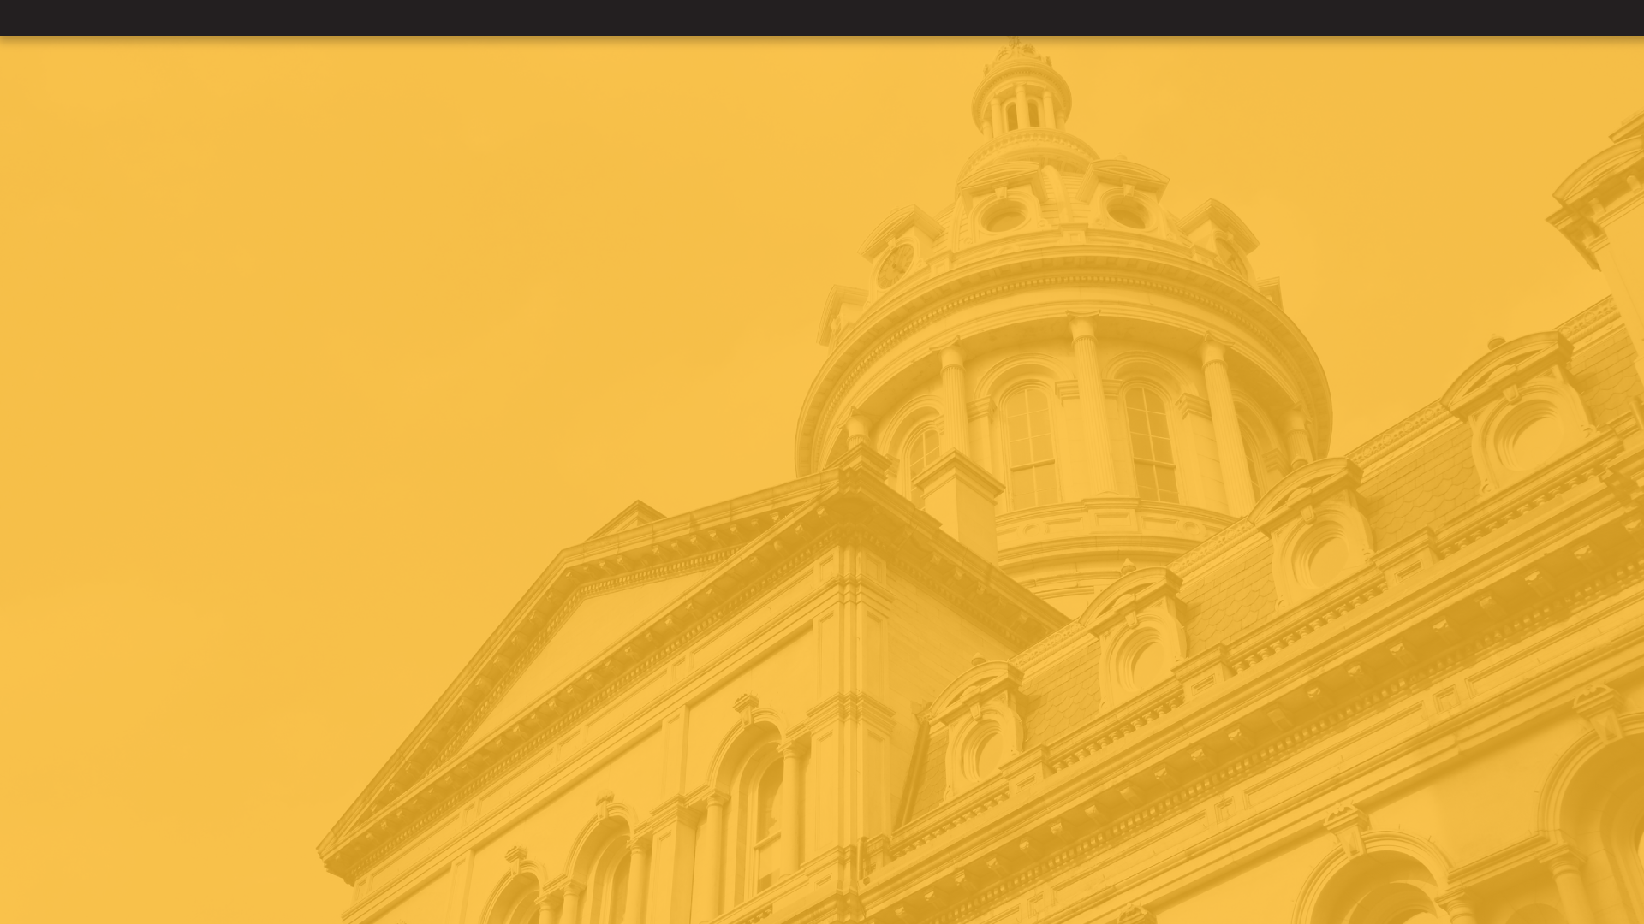
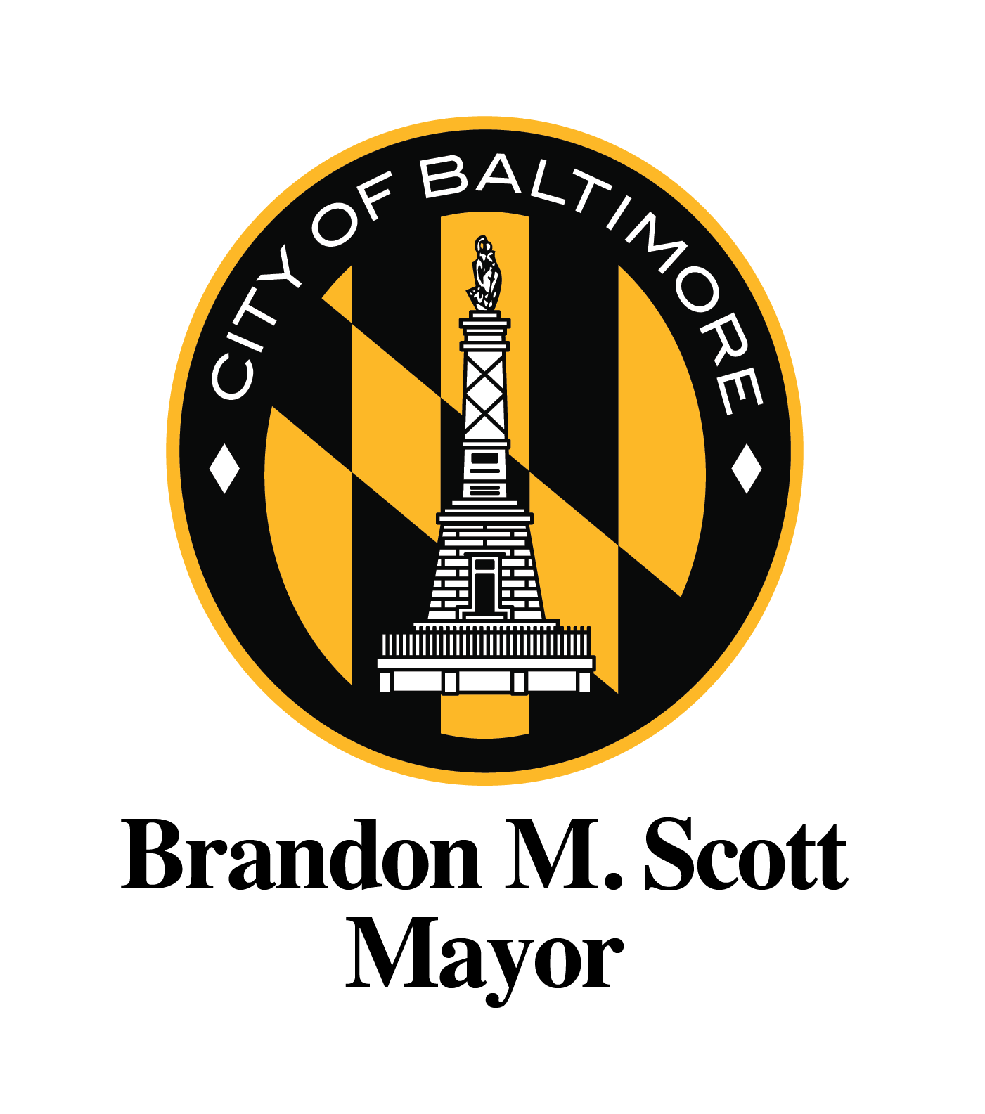
Baltimore Vacant Reinvestment Council
LO25-0029
PREPARED BY
Department of Housing & Community Development
June 16, 2026

Slide 2
Takeways from Today's Presentation
After today's presentation you should know:
What is Reframe Baltimore
What established Reinvest Baltimore
What Baltimore Vacants Reinvestment Initiative (BVRI) Is
Who is on the Baltimore Vacants Reinvestment Council (BVRC)
How the BVRC operates
How BVRI is funded and administered
How to get involved

Slide 3
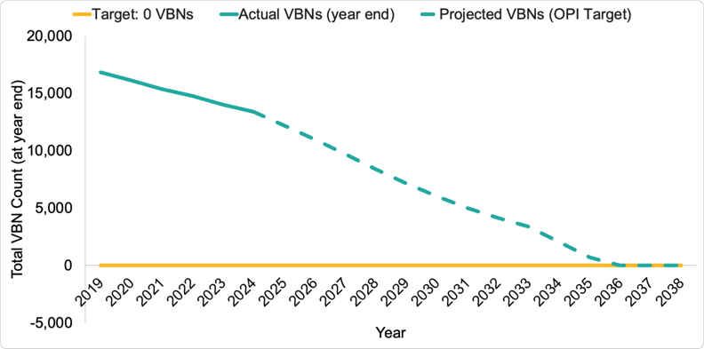
What is Reframe Baltimore?
15-Year Projected Trajectory of Vacant Building Notice (VBN) Abatement
Two Pillars
Reduce Vacant Buildings
Deliver on the Mayor’s 15-year goal of addressing the 13,000+ vacant properties across Baltimore
At steady-state, DHCD expects to resolve any new vacant buildings within 1-2 years
Produce Whole Block Outcomes
Stabilize neighborhoods through support to homeowners at risk and reduction of vacant properties and lots, so that future vacant properties are prevented, and communities thrive

Slide 4
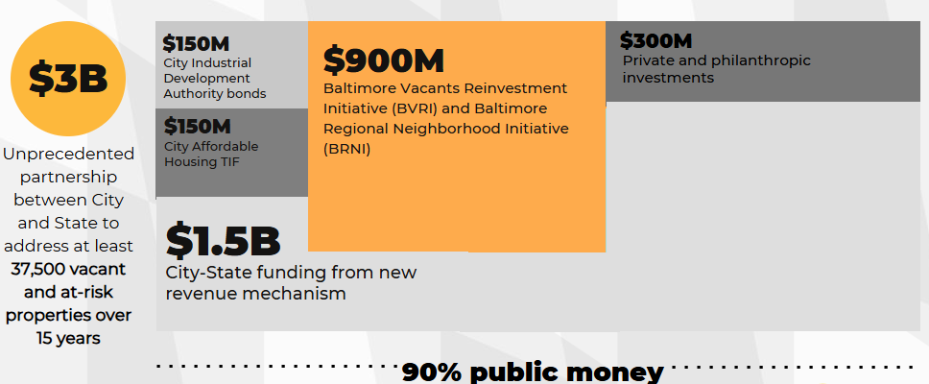
Reframe Baltimore Capital Stack
Historic City-State $3B capital stack pulls multiple financing sources to revitalize neighborhoods and create new homeownership opportunities.

Slide 5

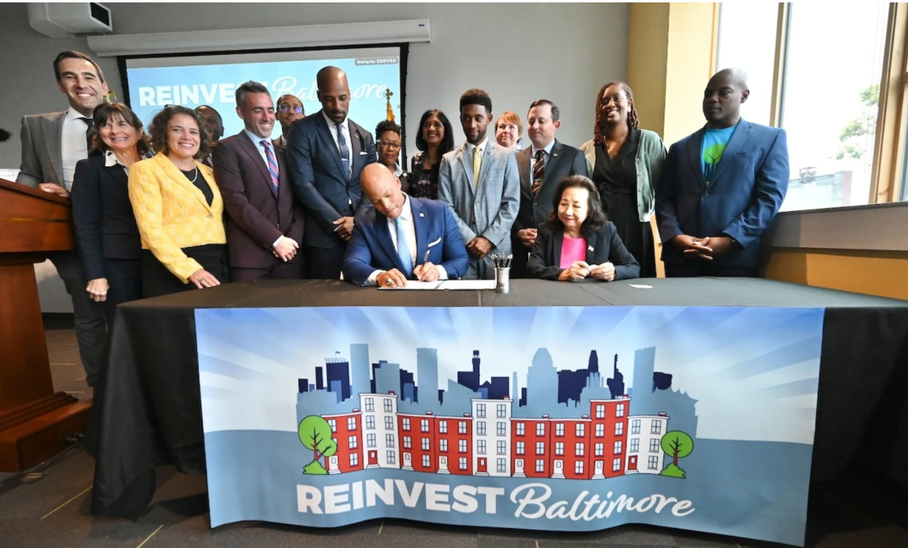
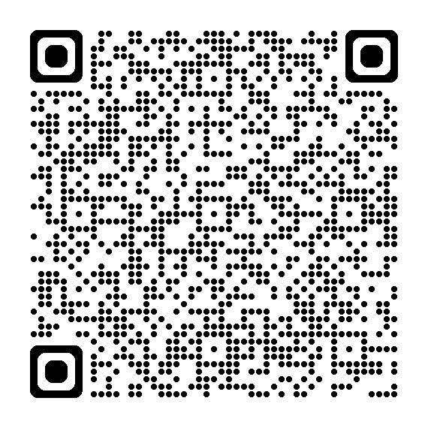
What is Reinvest Baltimore Initiative?
Established by Governor Moore's Executive Order 01.01.2024.34
The governor’s order calls for the establishment of the Baltimore Vacants Reinvestment Council which will tap key community, corporate, philanthropic and government leaders to leverage targeted investments to move at least 5,000 vacant properties into homeownership or other positive outcomes over the next five years.
BVRI redirects the previous Project C.O.R.E money to provide grant funding to public and nonprofit partners in Baltimore City to support vacant property revitalization.
Funds key redevelopment activities such as acquisition, stabilization, demolition, and pre-development work.
Creates opportunities for affordable housing, mixed-use projects, and new community green spaces
Executive
Order Link

Slide 6
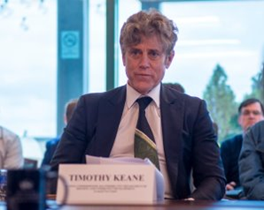
Who is on the BVRC?
Jake Day, Secretary, Maryland Department of Housing and Community Development (Chair)
Tim Keane, Acting Commissioner, Baltimore City DHCD (Vice Chair)
Portia Wu, Secretary, Maryland Department of Labor
Rebecca Flora, Secretary, Maryland Department of Planning
Gary McGuigan, Executive Vice President, Maryland Stadium Authority
Tom Sadowski, Executive Director, Maryland Economic Development Corporation
Jasmin Torres, Assistant Attorney General, Maryland Office of the Attorney General
Cory McCray, Maryland State Senator, Maryland General Assembly
Stephanie Smith, Maryland State Delegate, Maryland General Assembly
Faith Leach, Chief Administrative Officer, City of Baltimore
Michael Mocksten, Director, Department of Finance, City of Baltimore
John Bullock, Councilman, Baltimore City Council, 9th District
Leslie McMillan, Co-Chair, BUILD
Mark Anthony Thomas, President & CEO, Greater Baltimore Committee
Matt Gallagher, President & CEO, Goldseker Foundation
Beth Blauer, Vice President for Public Impact Initiatives, Johns Hopkins University
Otis Rolley, President & CEO, Baltimore Development Corporation*

Slide 7
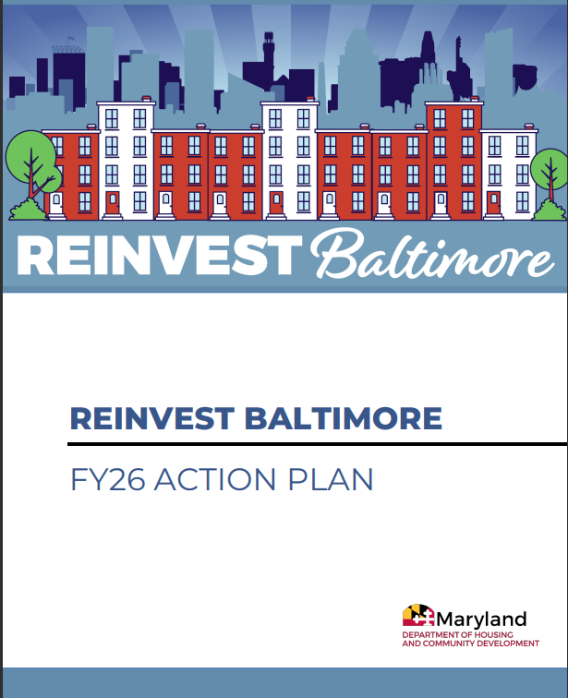
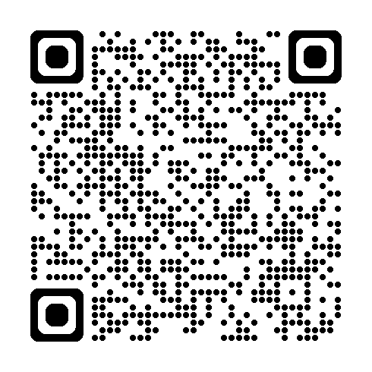
The Working Groups and Action Plan
The Council established four working groups in these key areas:
Finance
Economic Opportunity
Data
Delivery Chain (City and State Processes)
​
The Council and Working Groups are driven by the Reinvest Baltimore Action Plan, which established goals for the BVRC and each working group
Action Plan
Link

Slide 8
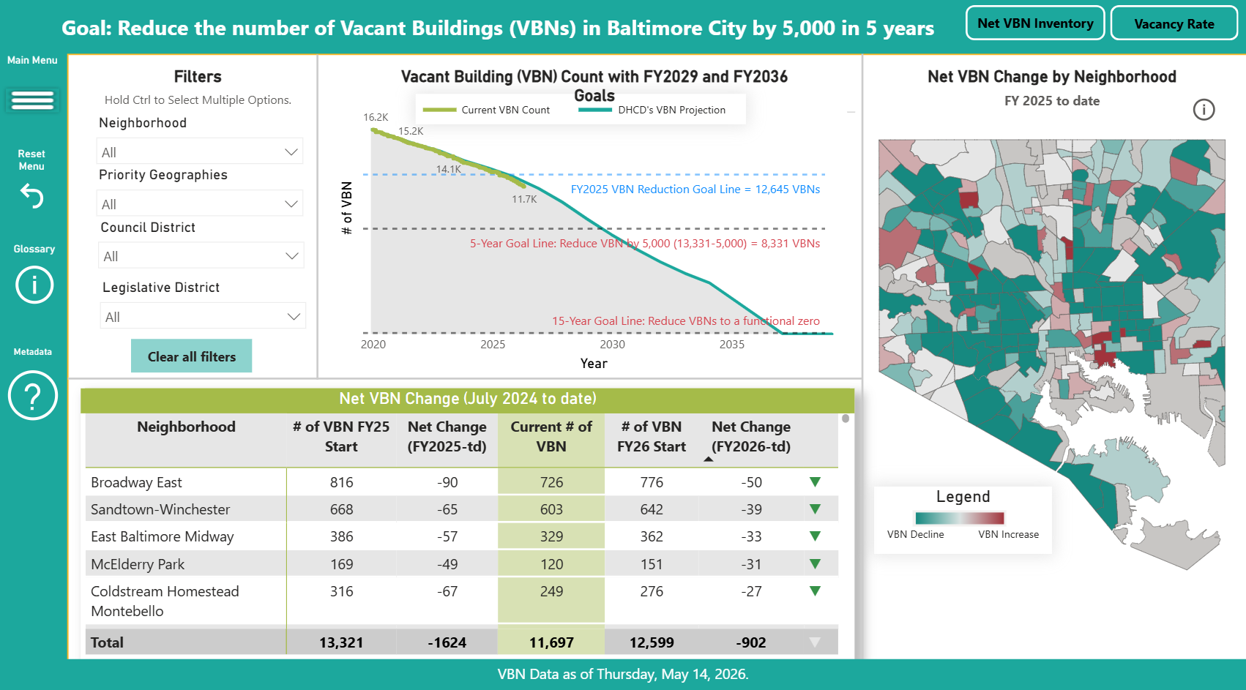
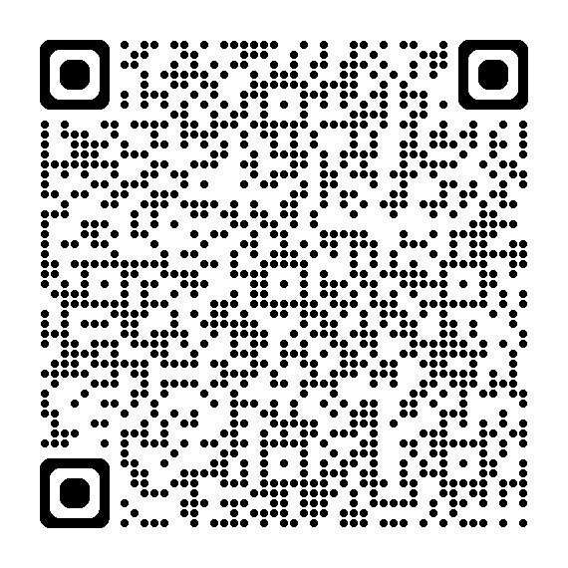
Reinvest Baltimore Dashboard
At the request of the Reinvest Baltimore Council, DHCD's Research and Analytics team created a dashboard that provides data and insights on the City and State’s Revitalization Strategy, goals, progress and processes including:
Overall Vacant Building Reduction
Code Enforcement
Acquisitions and Dispositions
Population Growth
Demolition and Stabilization
BVRC
Dashboard
Link

Slide 9
Funding of Reinvest Baltimore
Prior to the establishment of BVRI, Delegate Stephanie Smith established the $50M annually for BVRI through House Bill 1334 – The Continuation of the CORE Partnership Fund - which passed by the General Assembly in 2024.
The money administered by State DHCD is given to three parties:
(1) Maryland Community Investment Coorporation (MCIC) - MCIC grants money to Community Development Organizations (like SECDC, NHS, PHR, CHAI) who directly rehabilitation properties to achieve a use and occupancy permit. CDOs apply through State DHCD for funding. The most recent application round ended on April 1, 2026.
(2) Baltimore Department of Housing and Community Development – The City uses BVRI funding to accelerate the Vacancy Work related to Reframe Baltimore
(3) Maryland Stadium Authority (MSA) - MSA, from the direction of City DHCD, MSA demolishes and stabilizes properties within the City.

Slide 10
Coordination
City DHCD participates in two main coordination forums with BVRI partners: (1) bi-monthly public BVRC meeting focused on advancing Executive Order goals, and (2) a quarterly BVRI coordination meeting with City and State DHCD, Maryland Community Investment Corporation, and Community Development Organizations (CDOs).
To date, 36 coordination meetings have been held (including 14 in FY26 Q2 and 17 in FY26 Q3), with participation from 17 CDOs; additional meetings are ongoing in FY26 Q4.
These sessions have strengthened inter-agency alignment, improved funding and property data transparency, and helped address operational challenges such as permitting and lien-related barriers.

Slide 11
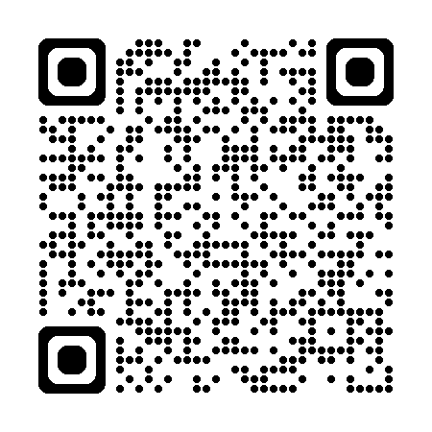
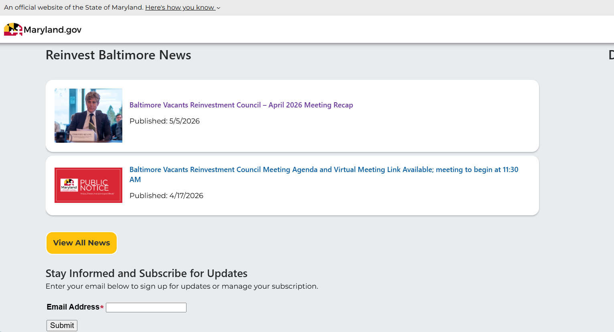
How to Stay Updated
The BVRC is open to the public and meets bi-monthly in person and online. The next BVRC meeting is June 29, 2026 from 11am-1pm. You can get updates on whats going on signing up for notifications on Maryland DHCD's Website using the QR Code Below:

Slide 12


THANK YOU!

