Slide 1
Oversight of Recovery Homes and Substance Use Disorder Clinics
in Baltimore City
April 29, 2026
LO25-0024

Slide 2

BHSB’S HISTORY
BMHS, 1986
BSAS, 1990
BHSB, 2013
Robert Wood Johnson grant
Targeted Cities grant
Intentionally created as non-profits
Formed through merger

Slide 3






BHSB’S CORE
FUNCTIONS
Advocacy &
Planning
Local
Partnerships
System
Management
Managing
Public Funds
Public
Education

Slide 4
SUD Programs and Recovery Residences

Slide 5
Substance Use Disorder Clinics
SUD treatment programs require accreditation and licensure
Licenses are based on American Society of Addiction Medicine (ASAM) guidelines
Outpatient programs:
  Outpatient Treatment Level 1.0
  Intensive Outpatient Treatment Level 2.1
  Partial Hospitalization Treatment Level 2.5
Residential programs:
  Residential-Low Intensity Level 3.1
  Residential-Medium Intensity Level 3.3
  Residential-High Intensity Level 3.5
  Residential-Intensive Level 3.7
Specialty licenses:
  Withdrawal Management Service
  Opioid Treatment Service (OTP)

Slide 6
Pause on BH Provider Enrollment Still in Effect
On 7/1/24, MDH issued a pause on newly enrolling provider types:
Psychiatric Rehabilitation Programs (PRPs)
SUD Partial Hospital Programs (PHP)
SUD Intensive Outpatient Treatment Programs (IOP)
On 11/26/25 MDH extended the pause through 6/30/26 in ten jurisdictions:
  Baltimore City
  Nine other populous Maryland jurisdictions (Balt Co, Anne Arundel, Howard, Harford, Carroll, Frederick, Washington, Montgomery, Prince George’s)

Slide 7
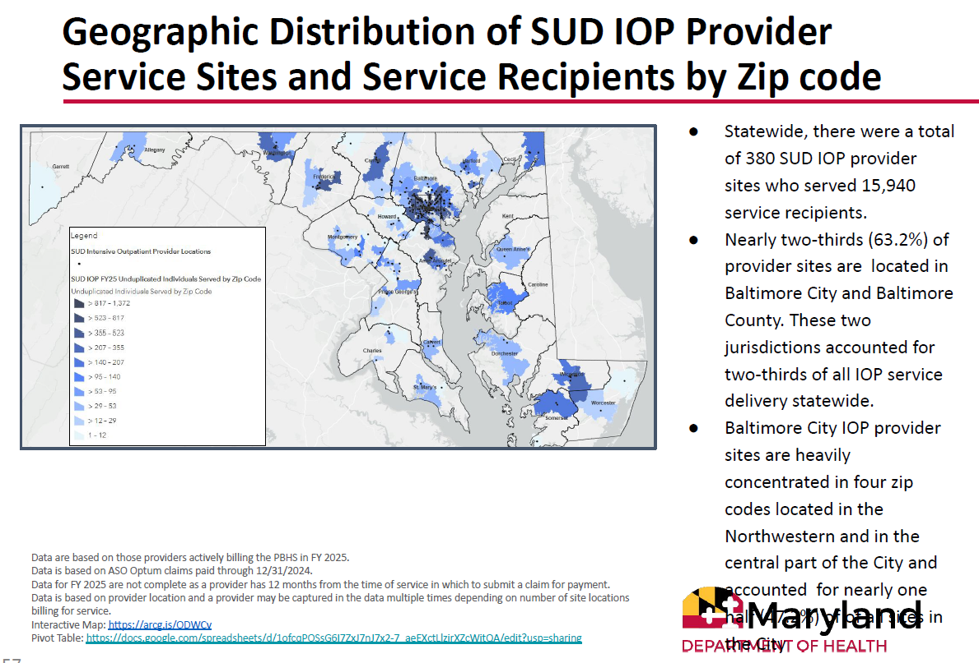

Slide 8
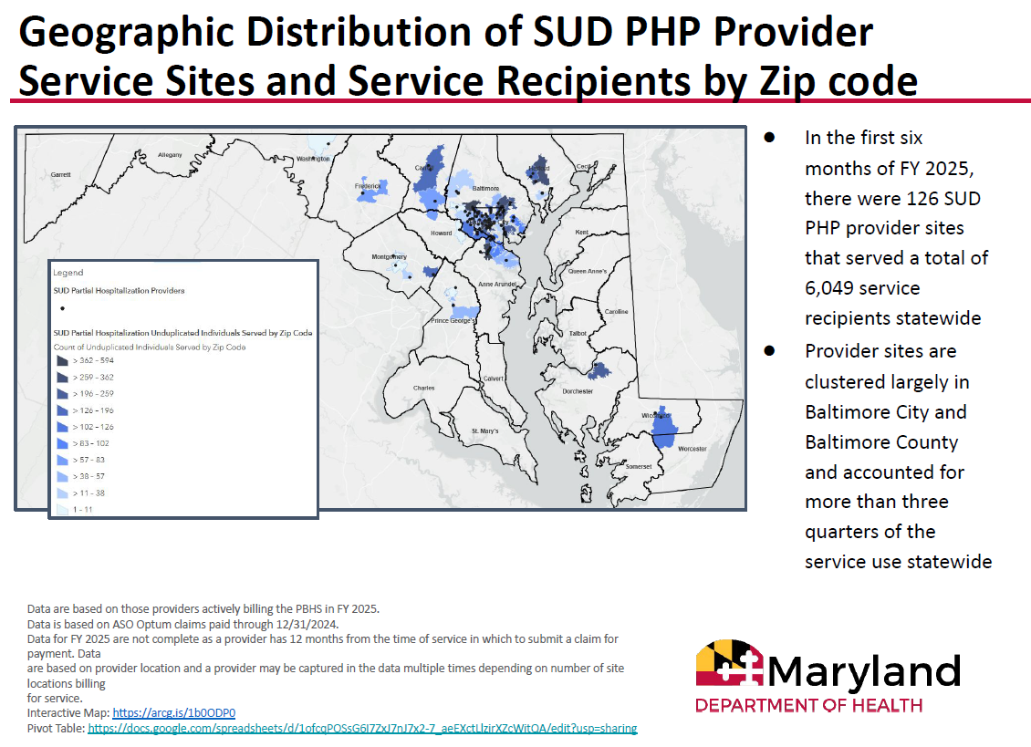

Slide 9
Recovery Residence
Certification from Maryland Certification of Recovery Residences (MCORR)
Certification ensures residences provide safe, healthy, community-orient environments
BHA responsible for certification, oversight, and investigations
To obtain state recovery home funding, the residence must be certified
Currently 44 certified recovery housing programs in Baltimore

Slide 10
COMAR 10.63 Community Behavioral Health Regulation Revisions

Slide 11
COMAR 10.63 Overview
COMAR 10.63, the state regulations that govern community-based behavioral health providers
COMAR 10.63 includes definitions and requirements that apply to certain provider types
Rules related to licensing and accreditation set in COMAR
General expectations for provider accountability set in COMAR

Slide 12
Overview of revisions:
Intended to address provider accountability and service quality
Establishes new expectations for certain provider types
Provides new tools for system accountability
Adds new requirements for recovery residence certification
COMAR Revisions
COMAR 10.63 - Community-Based Behavioral Health Programs and Services

Slide 13
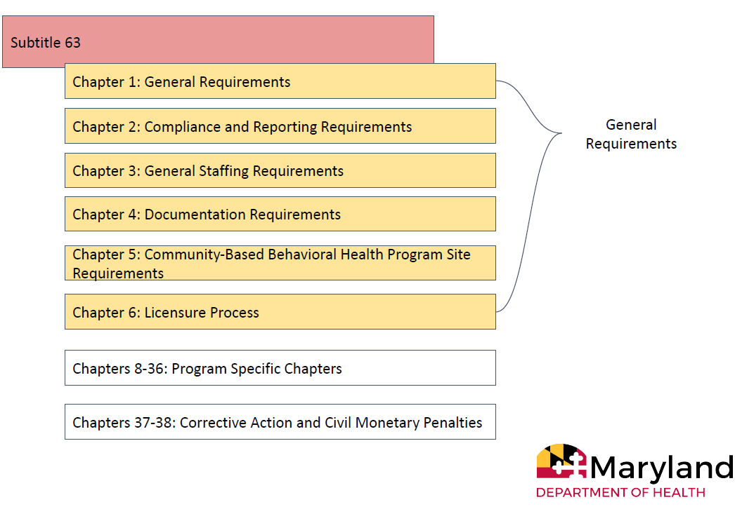
Structure of draft regulations

Slide 14
Recovery Residences in COMAR 10.63 Revisions
New 10.63.27 subsection governing recovery residence program
Incorporates National Association of Recovery Residences Standards
Defines the certification process including annual inspections
Establishes NEW requirement that all recovery residences must be certified

Slide 15
Timeline of Activities:
Summer 2024: Unofficial draft of COMAR 10.63 revisions released for stakeholder feedback
May 2025: Official draft regulations published in MD Register (included Chapters 1,2,6,9)
August 2025: MDH rescinds draft regs
Dec 2025 - March 2026: Stakeholder convenings to obtain agreement w/stakeholders​
Formal promulgation in MD Register expected soon in the coming months
COMAR Revisions
COMAR 10.63 - Community-Based Behavioral Health Programs and Services

Slide 16
Provider Accountability

Slide 17
BHSB provides leadership, management, oversight, and operations functions at the local level in collaboration with the BHA and the Medicaid Administrative Services Organization (ASO).
Link: Manual for Managing the PBHS in Maryland
BHSB Accountability Functions:
Conducting regular audits and site visits
Approving and monitoring Corrective Action Plans, Performance Improvement Plans, and Program Improvement Plans
Complaints protocols, resolutions, and tracking
Investigation and Tracking of Critical Incidents – suspected abuse/neglect, staff misconduct, suspected fraudulent practices, overdose, death of a participant, etc.
Provider
Accountability
Monitoring for quality and outcomes

Slide 18
Provider Relations
BHSB proactively engages provider network around best practices, responding to community needs, adapting to system changes, and advocating for the PBHS
Quarterly provider convenings
Monthly provider updates
Focus groups on key issues
Site visits with new providers
Resource information sharing
Provider-relations@bhsbaltimore.org

Slide 19
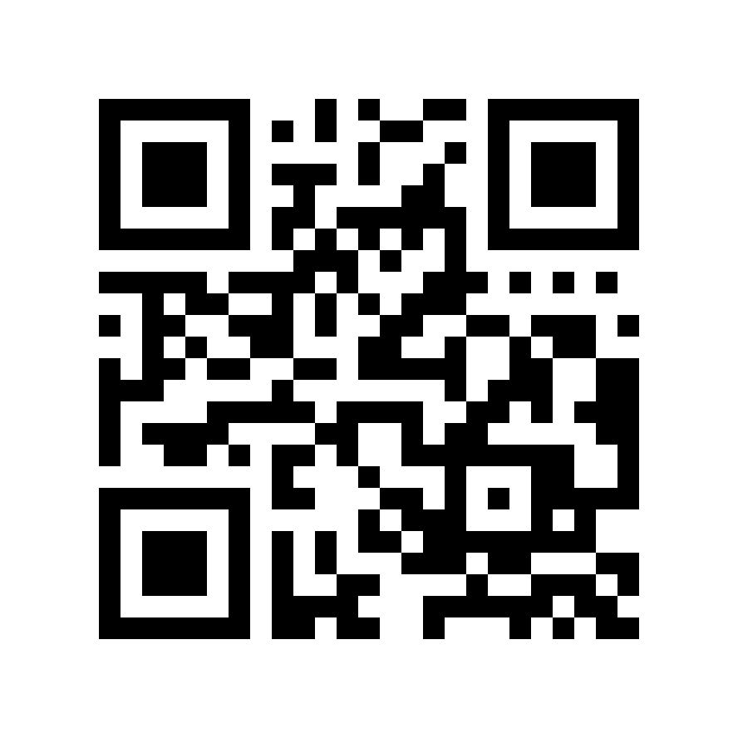
Q: Who can submit a complaint about a provider to BHSB?
A: Anyone can submit a complaint about a behavioral health provider or BHSB to the BHSB Investigations Team. Use the QR code to the left to access the complaint form and process, or visit: File a complaint about a provider or BHSB.
Q: How else can I submit a complaint about a provider to BHSB?
A: You may email: complaints@bhsbaltimore.org, or call 410-637-1900, option 5.
Q: What happens after I report an issue to BHSB?
A: BHSB’s Investigations Team will follow up with the complainant within 2 business days to gather additional information.
The team will then conduct a thorough investigation of the complaint received. Complaints are typically resolved within 30 days if they do not require additional involvement from state agencies.
Provider Complaints

Slide 20
New Behavioral Health Administrative Services Organization (ASO) Activities
Improved coordination with LBHAs on provide audit findings and performance improvement plans
Required LBHA follow up regarding performance improvement plans
Regular provider audits
Improved utilization management
Reconciling data from previous ASO

Slide 21
2026 Legislative Session

Slide 22
BHSB Policy Priorities
Promote high quality behavioral health services and provider accountability within the public behavioral health system
Ensure Marylanders continue to have access to the full range of behavioral health services through Maryland’s Medicaid program
Strengthen and expand the behavioral health workforce to ensure timely access to high-quality behavioral health care
Increase affordable housing options for those with behavioral health needs, including quality recovery housing and permanent supportive housing
Implement policies to reduce law enforcement and criminal justice interaction for people with behavioral health needs
Maximize the impact of state and local opioid restitution funds by investing in overdose prevention strategies, connections to treatment, and recovery support services

Slide 23
2026 Legislative Session
Behavioral Health in the Budget
Flat funded behavioral health rates and grants
Restored cuts to school mental health funding
Restored state commitment to pursuing Certified Community Behavioral Health Clinics (CCBHCs)
Allocated funding for IT improvements and enrollment assistance for Medicaid enrollees subject to new federal eligibility requirements

Slide 24
2026 Legislative Session
Recovery residence legislation
HB448/SB878: Health Facilities - Certified Recovery Residences - Unannounced Inspections
  Neither bill moved forward.
SB876: Recovery Residences - Certification – Requirement
  Did not move forward but is included in forthcoming regulation
HB1249: Certified Recovery Residences - Refusing Services to Individuals Receiving Medication-Assisted Treatment – Prohibition
  Passed both chambers and is awaiting Governor’s signature

Slide 25
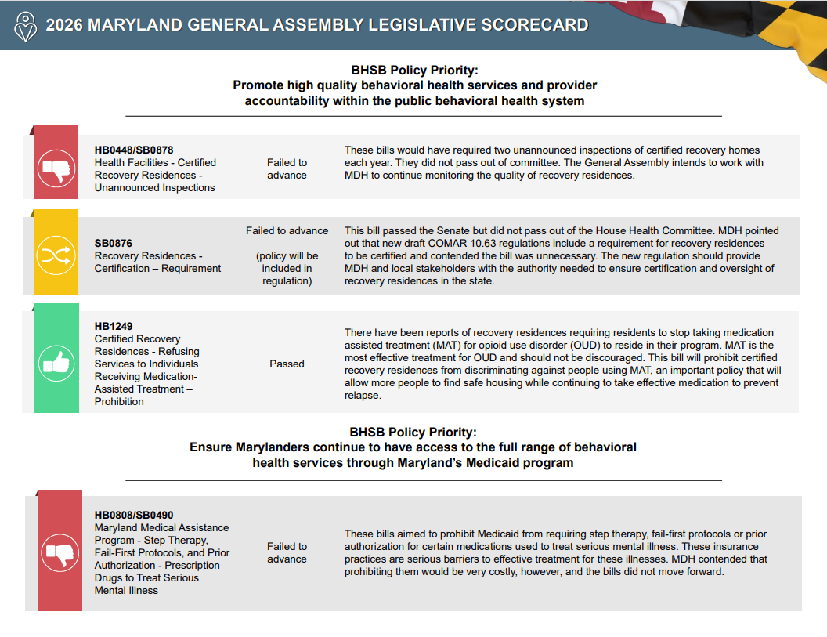
BHSB Legislative Scorecard
Sign up for policy alerts:
www.bhsbaltimore.org/get-involved/advocate/

Slide 26
Next Steps
Finalization of COMAR 10.63 revision
  Publish in the MD Register
  Comment period
  Finalization and implementation
    New recovery residence certification requirement
    New SUD clinic licensing, staffing, and services requirements
Improved ASO utilization management and oversight
  Improving coordination with LBHAs
Commission on Behavioral Health Treatment and Access
Implementation of new laws
Continued implementation of CCBHCs

Slide 27
Adrienne Breidenstine
Vice President, Policy & Communications
Adrienne.Breidenstine@bhsbaltimore.org
Dan Rabbitt
Director, Policy
Daniel.Rabbitt@bhsbaltimore.org

