Slide 1


Whole Block Strategy & Disposition Timelines
LO25-0029
PREPARED BY
Department of Housing & Community Development
June 16, 2026

Slide 2

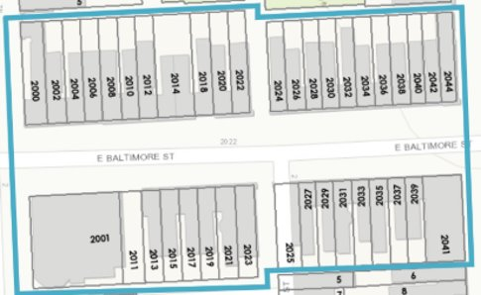
Whole Block Strategy
"Whole Block" is defined as two sides (block faces) of a street facing each other from corner to corner.
Vacant Buildings
Vacant Lots
Homeownership Preservation
Infrastructure
  Sidewalks
  ADA Ramps
  Tree Pits
2000 Block of E Baltimore St

Slide 3
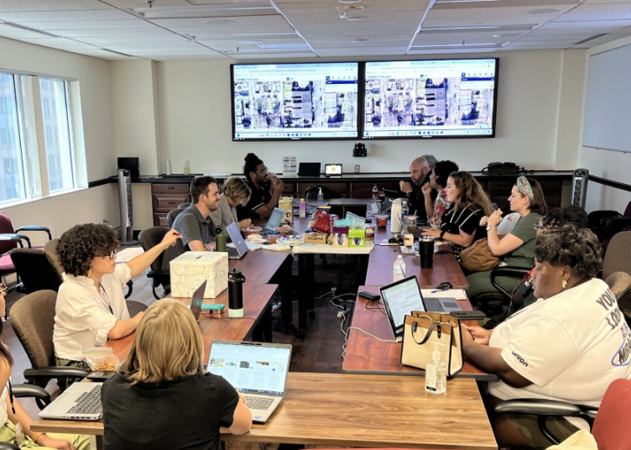
What is Block Level Planning?
Block Level Planning (BLP) is the cross-agency activity that determines the property-level strategies in chosen priority blocks for DHCD and other agencies to implement in the coming fiscal years.

Slide 4
Vacant Reduction Priority Geographies
Impact Investment Areas | Neighborhoods | Strategic Blocks
Broadway East IIA | Boyd-Booth | Allendale
Coldstream Homestead Montebello IIA | Brooklyn | Auchentoroly-Parkwood
East Baltimore Midway IIA | Carrolton Ridge | Berea
Johnston Square IIA | Curtis Bay | Biddle Street
Park Heights IIA | Darley Park | Edgewood
Southwest Partnership IIA | Harlem Park | Edmondson Village
West IIA | McElderry Park | Ellwood Park/Monument
 | Midtown-Edmondson | Mosher
 | South Clifton Park | Oliver
 | Westport | Penrose/Fayette Street Outreach
 |  | Shipley Hill
 |  | WNADA

Slide 5
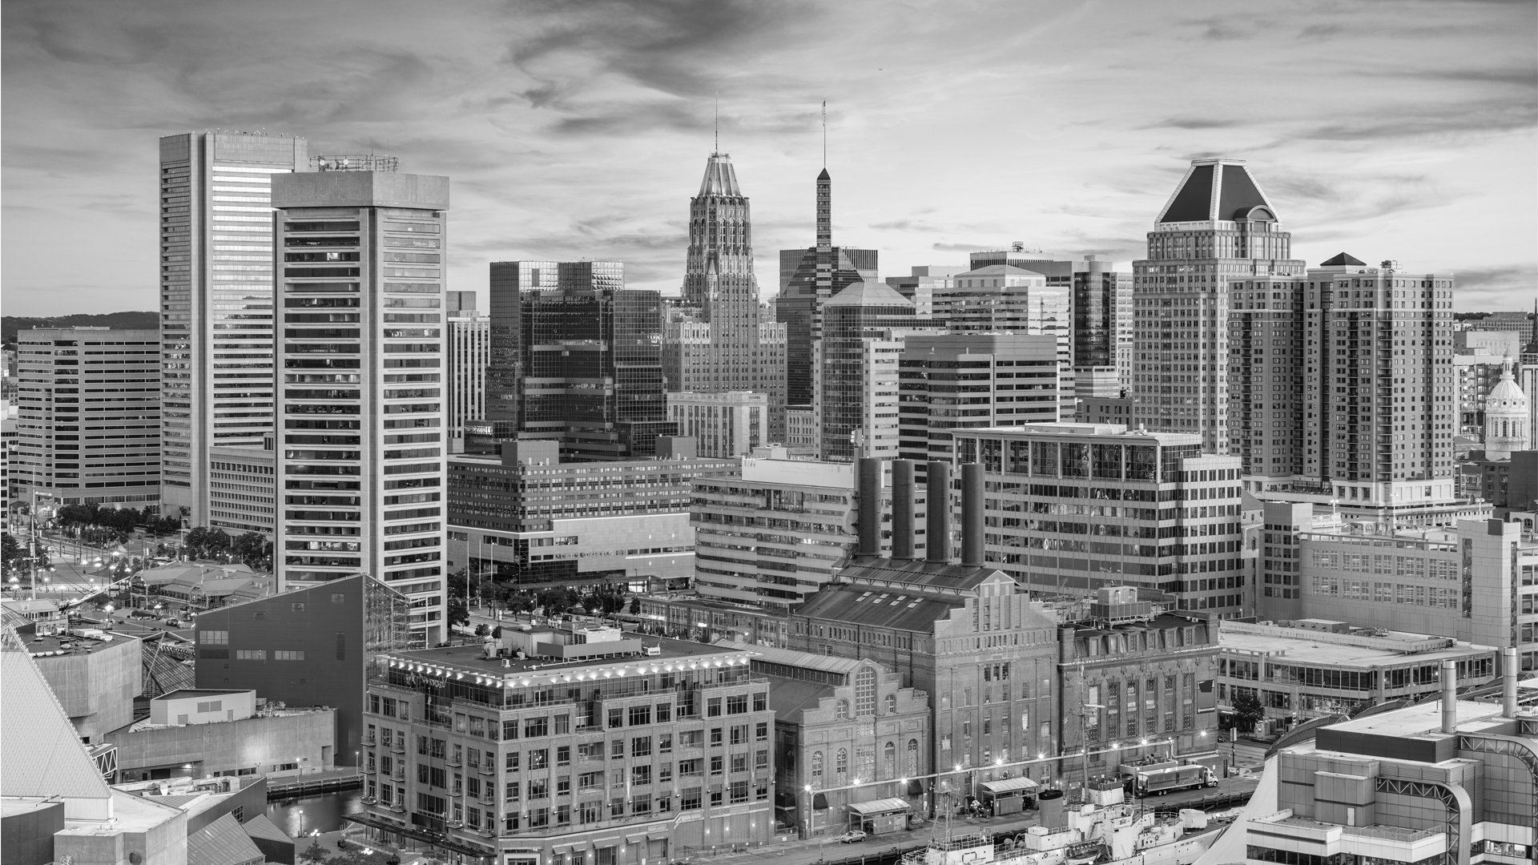

Successful Whole Block Strategy

Slide 6
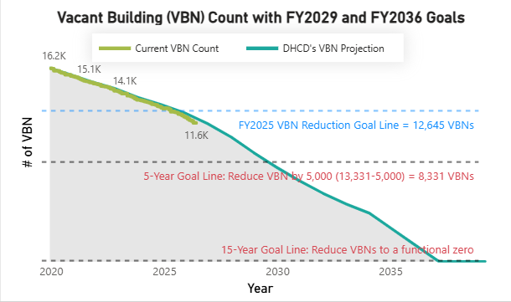
Vacancy Reduction Goals
Current VBN Count:
11,633
As of 6/15/2026

Slide 7
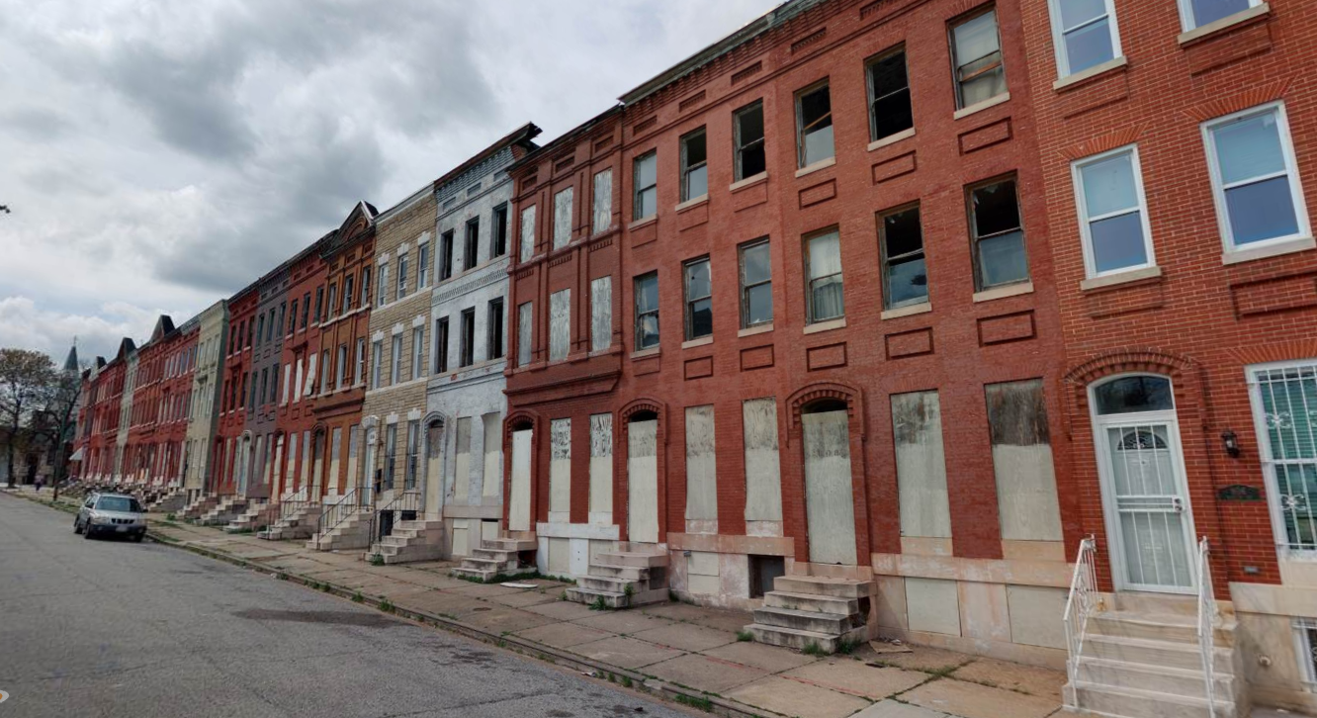
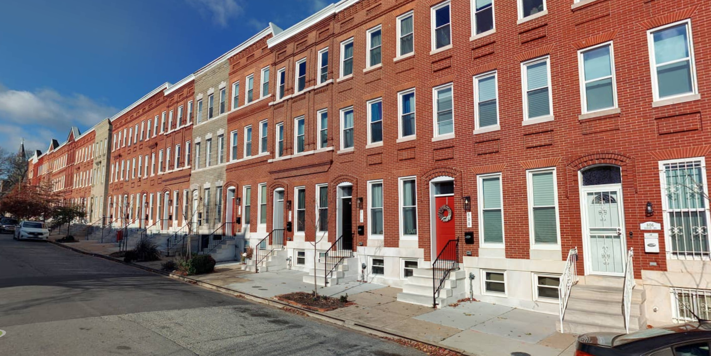
800 Blk Harlem & Edmondson Ave.
The 800 block of Harlem included a total of 38 city-owned vacant properties. The project meets DHCD goals of both addressing blight and revitalizing beautiful and historically significant blocks that can act as anchors for future redevelopment efforts.

Slide 8
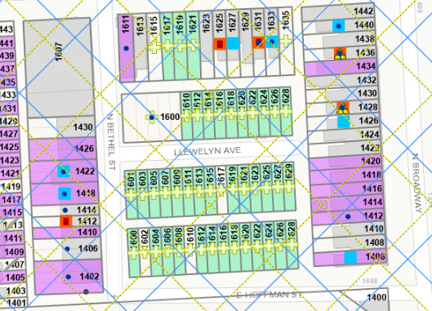
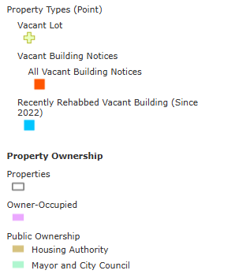
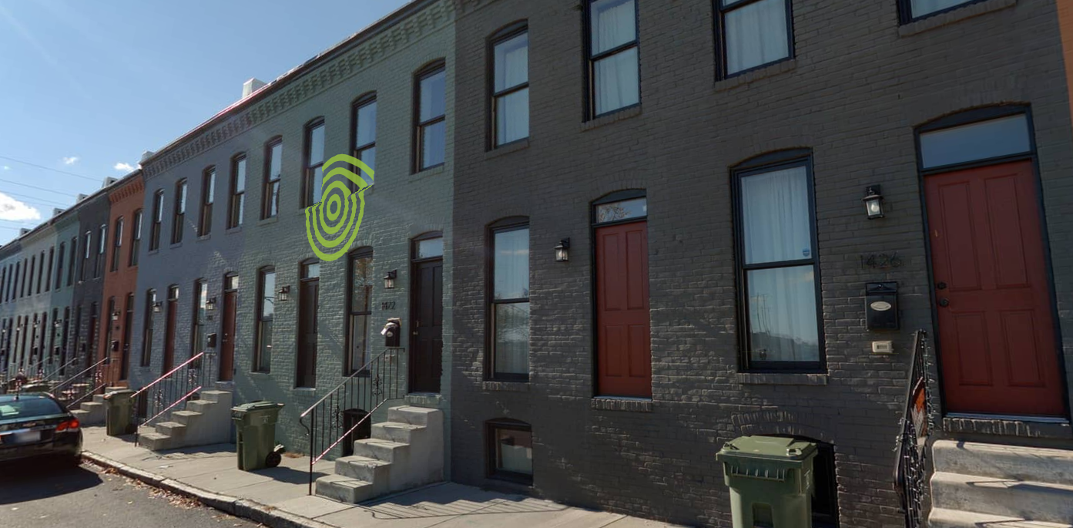
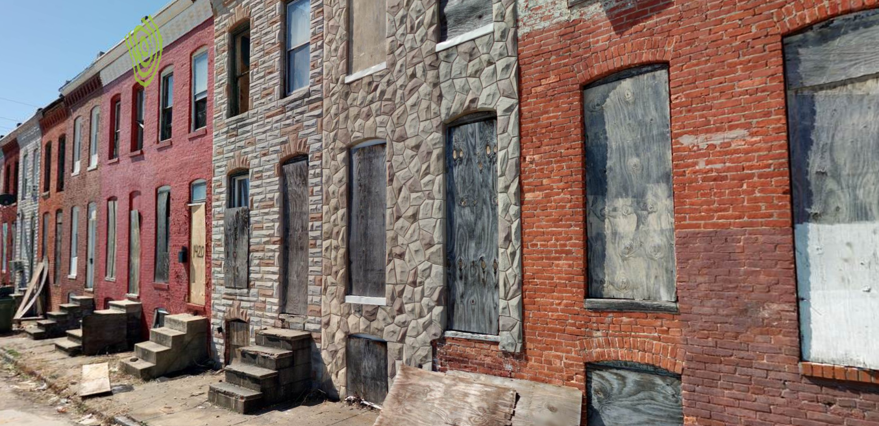
1400 Blk Bethel Ave.
The rehab 1400 blk of Bethel successfully reduced density and increased homeownership.

Slide 9
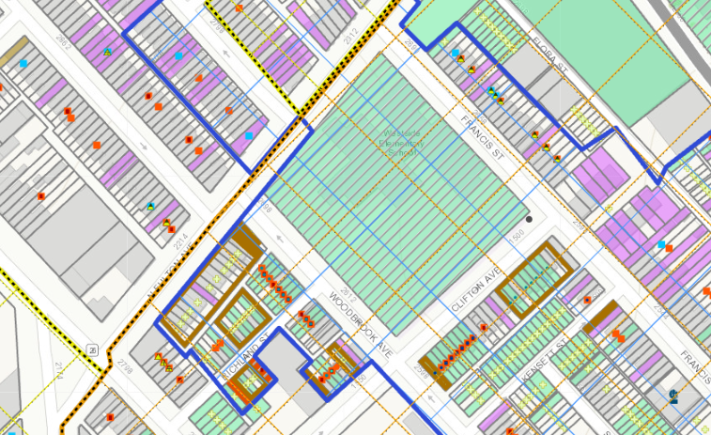
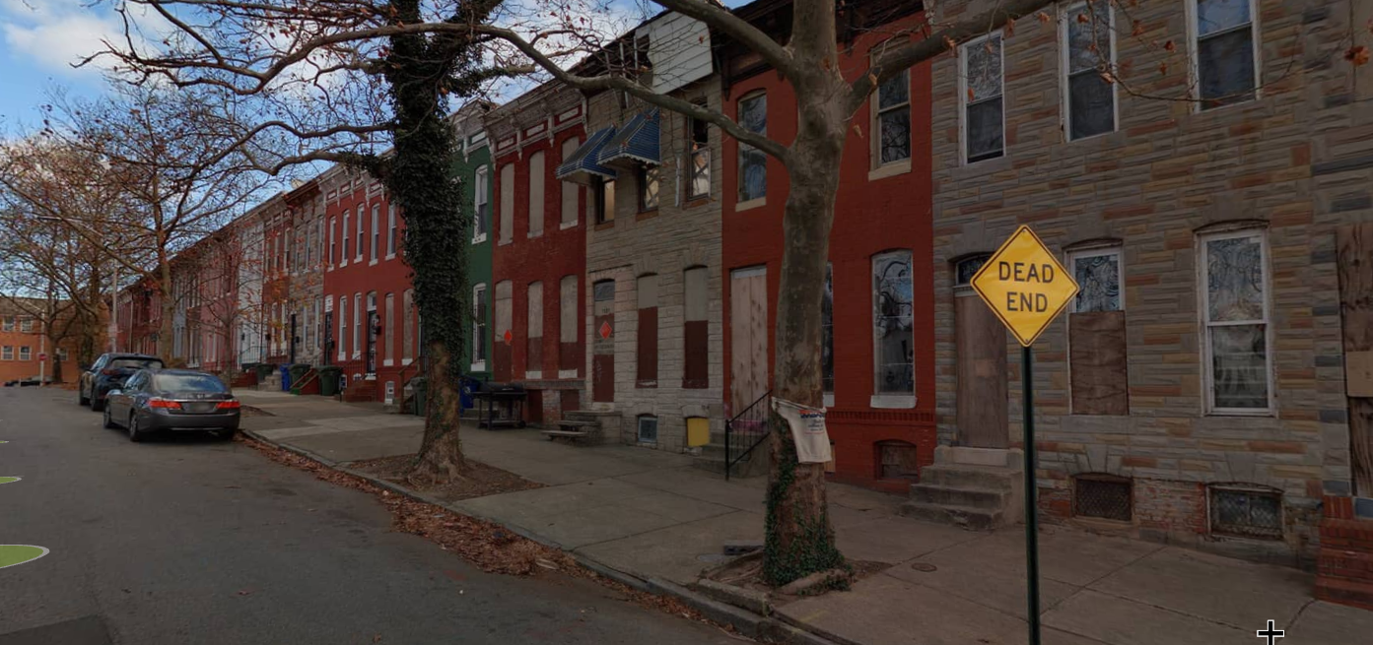
Parkview Rec Project – 1500 Blk Clifton Ave
The Parkview Rec Project will result in 30 homeownership opportunities. The developer cohort has begun clean out and stabilization on Clifton and Woodbrook Ave. Full rehab underway on Francis St.

Slide 10
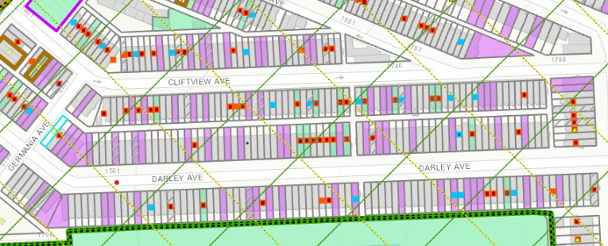
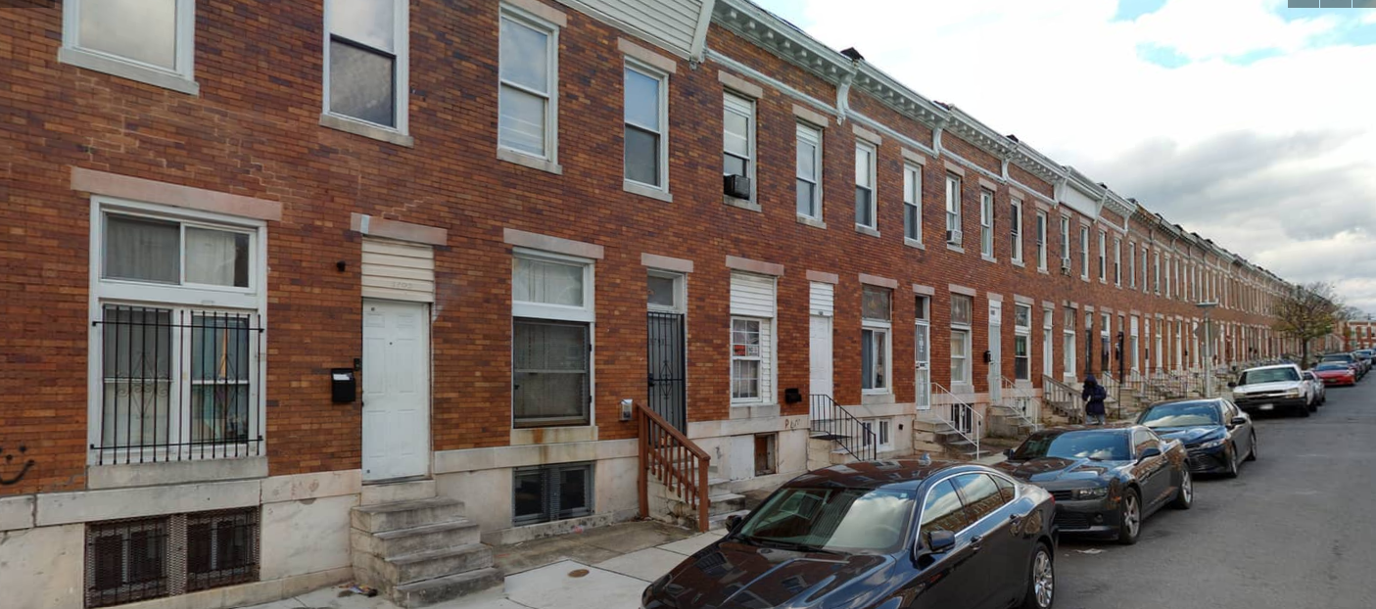
1600 Blk Cliftview & Darley Ave.
DHCD and its development partner have secured site control and rehab is underway.

Slide 11
Disposition Timelines

Slide 12
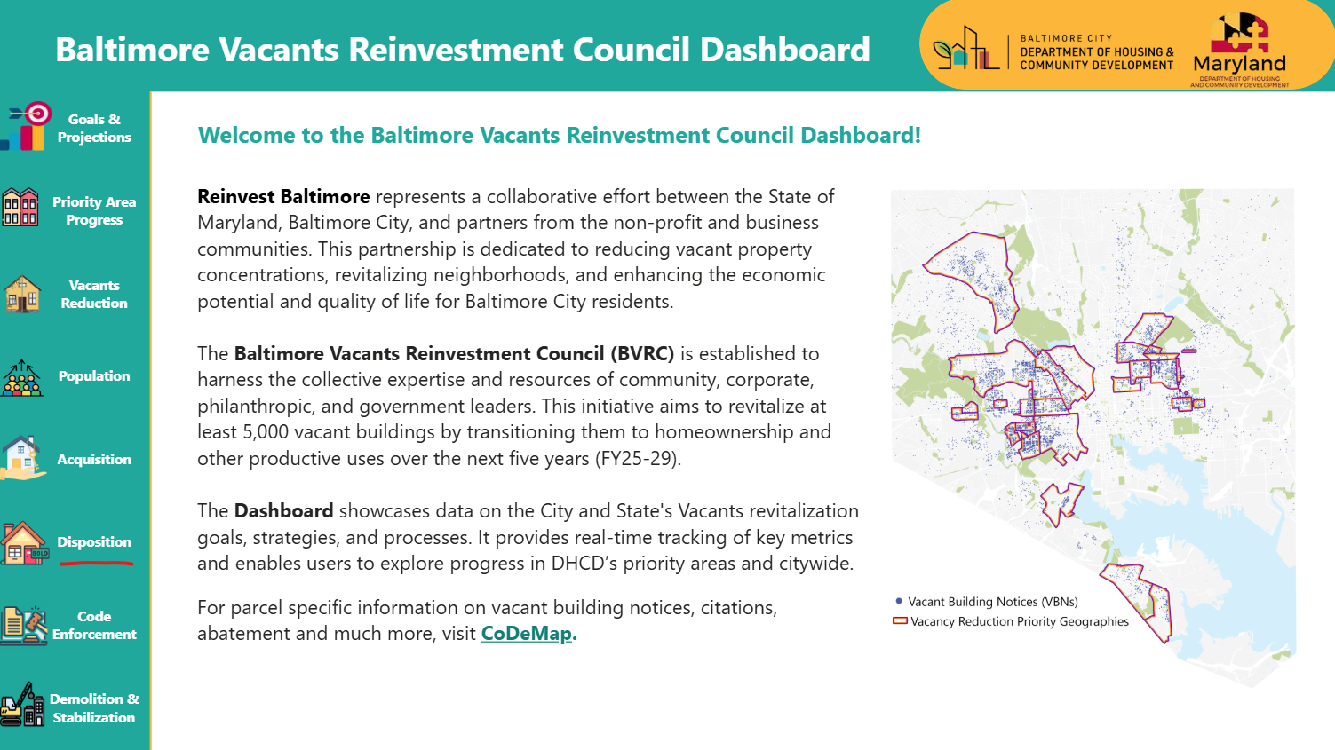
Disposition Timelines - FY26 YTD
% of Dispositions Complete in 120 Days | 30%
Average Disposition Time | 193 Days
Total Dispositions | 196

Slide 13
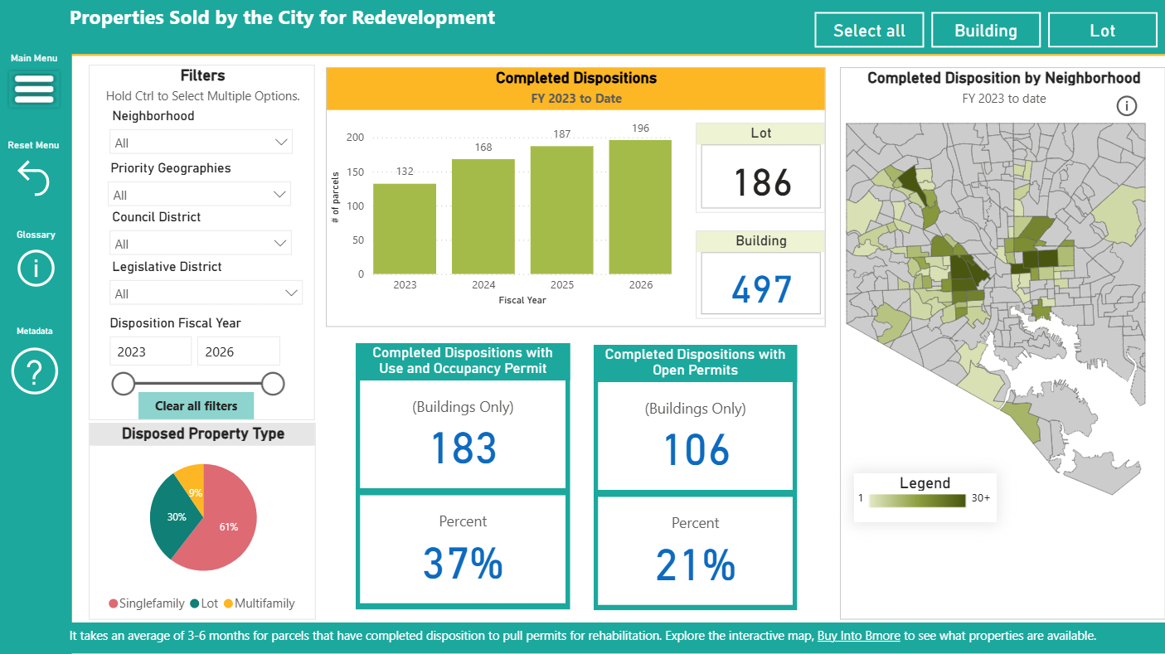

Slide 14

THANK YOU!

