Slide 1
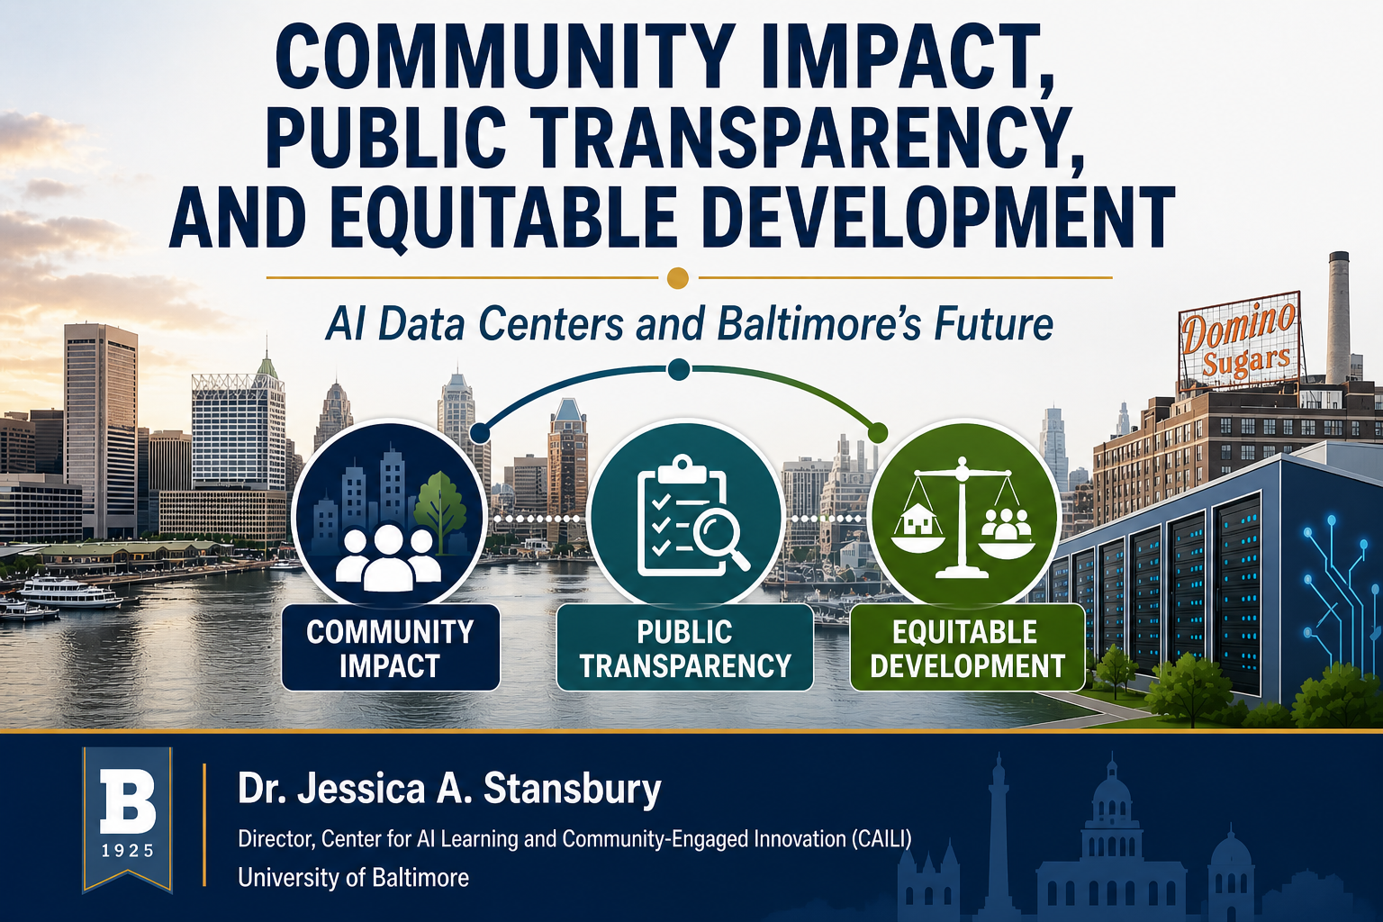


Slide 2
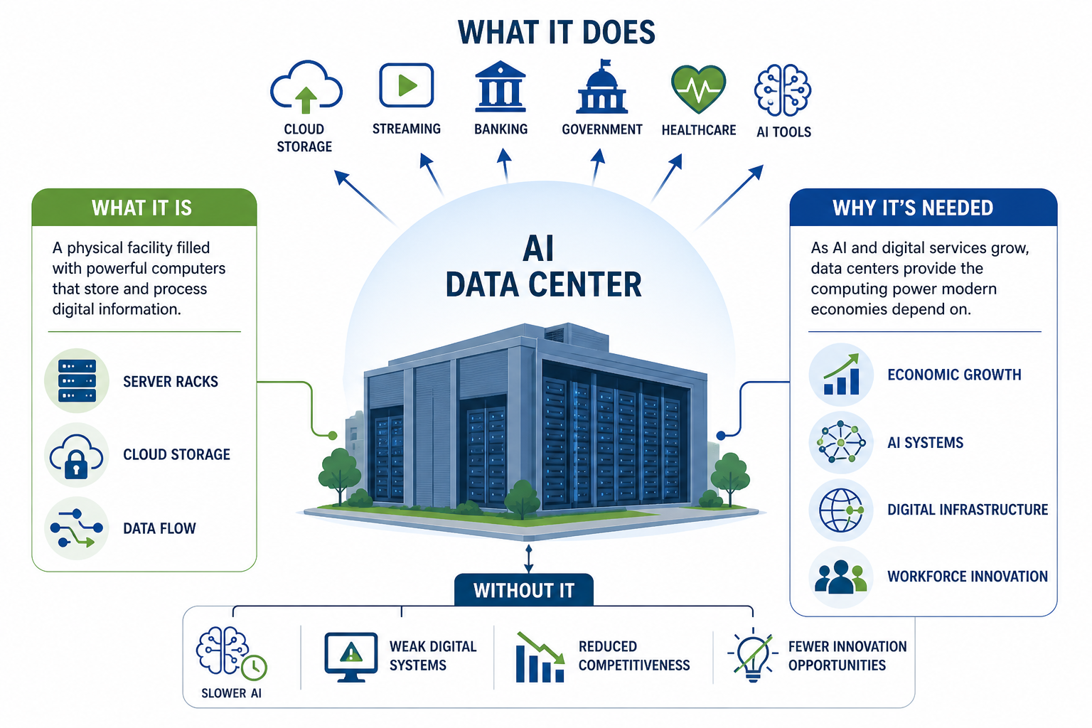
Notes:
What is a data center? What does it do? Why is it needed? And what happens without it?

Slide 3
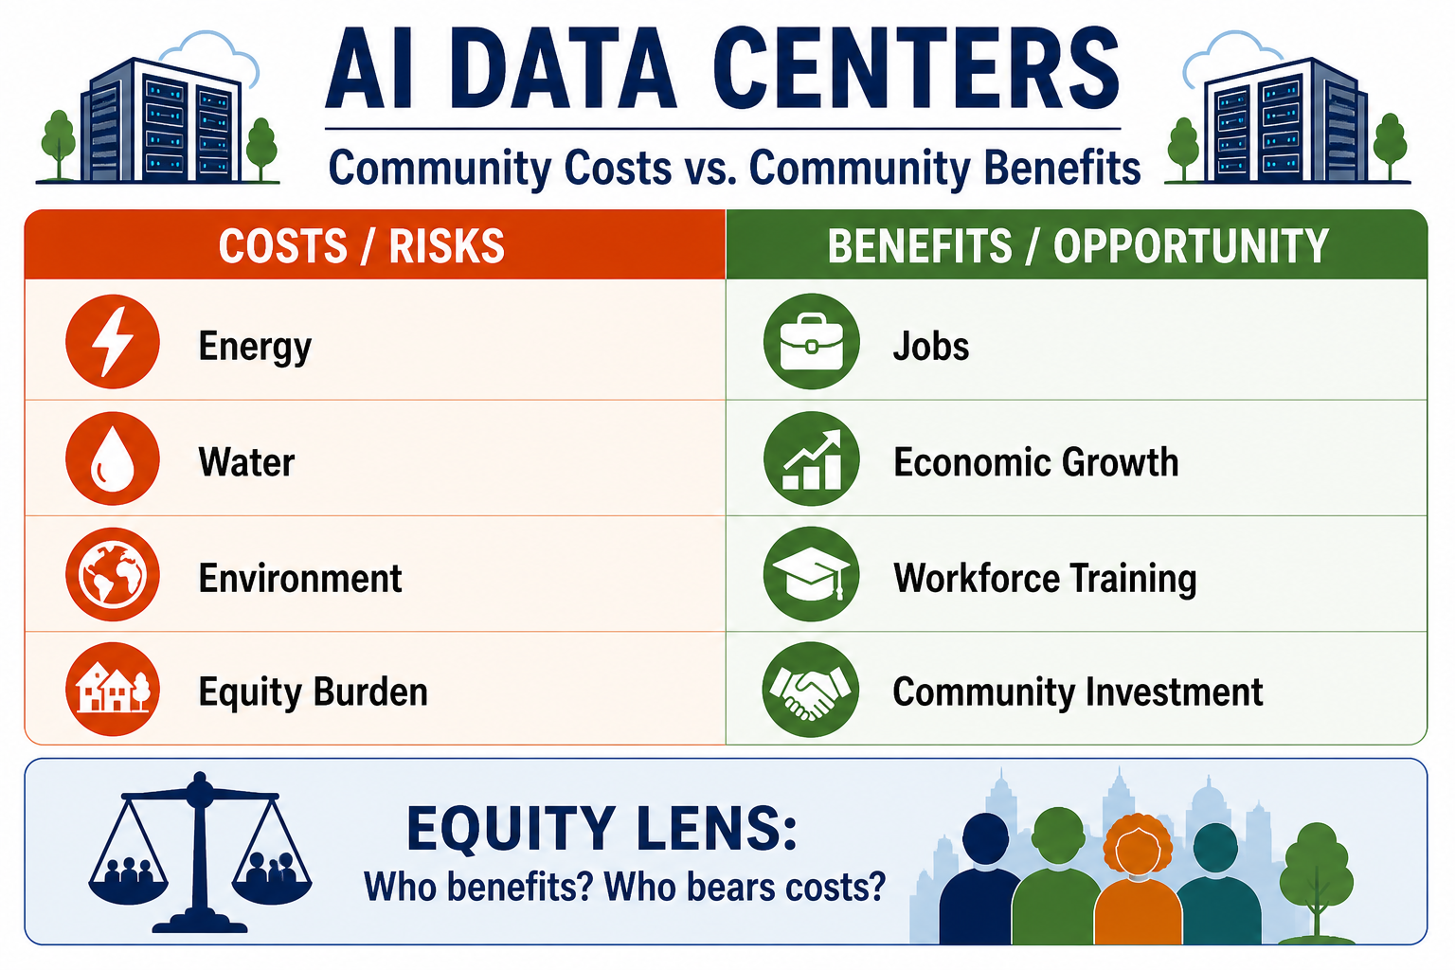
Notes:
What are the costs/benefits? Who carries them?
As AI infrastructure expands, evidence indicates that energy and water demands must be carefully balanced against local community needs.
AI data centers are not inherently harmful or beneficial—their impact depends on governance, transparency, and equity
Innovation without safeguards can deepen inequity; innovation with accountability can strengthen communities

Slide 4
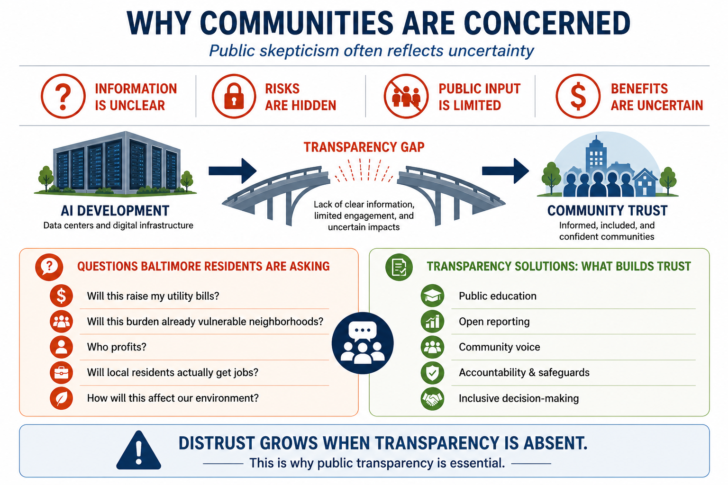
Notes:
How do we build informed public trust? CAILI is not pro-AI, or anti-AI, our goal is to provide the education and training to help community leaders engage in the conversation leading to informed decisions.
When communities do not understand what is being built, distrust becomes the default response.
Research consistently shows that public resistance often emerges not solely from opposition, but from exclusion, uncertainty, and lack of trust

Slide 5
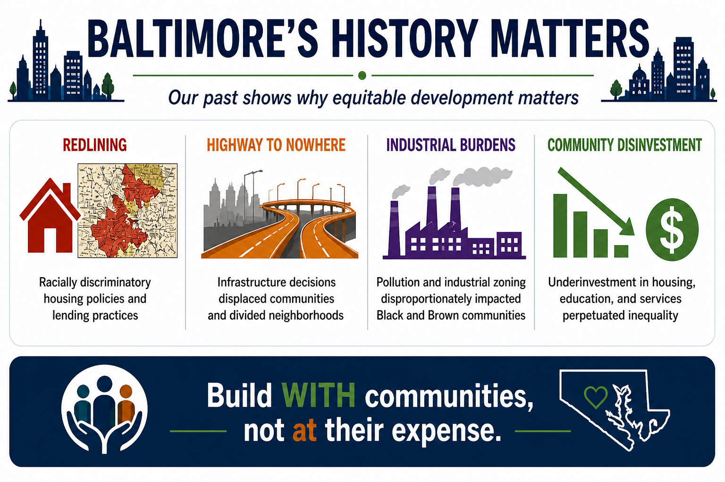

Slide 6
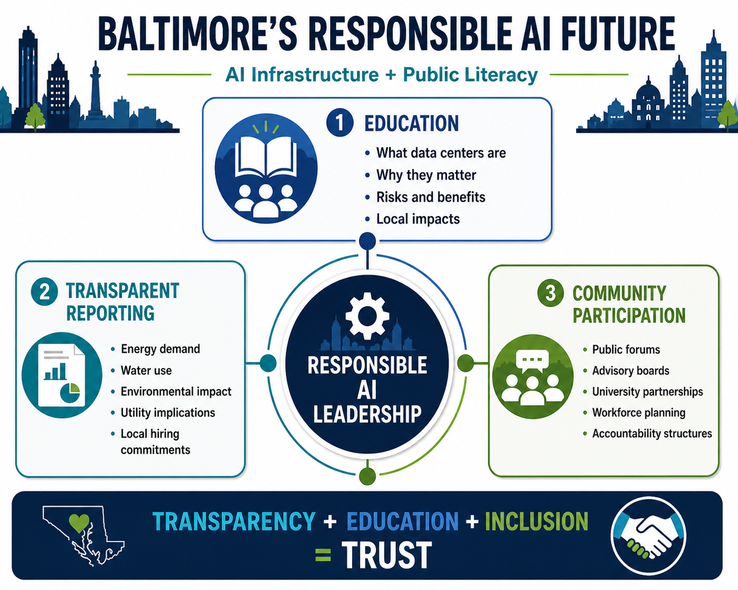

Slide 7

Thank you!
Contact Information: jstansbury@ubalt.edu

