Slide 1

Baltimore City Council:
Public Safety Committee Legislative Oversight
Crime Reduction and Violence Prevention
May 13, 2025
Vincent Schiraldi, Secretary
Presenter:
Lisa M. Garry, Deputy Secretary, Community Services

Slide 2
PRESENTATION TOPICS
Overview of System Processing
Review Data Trends
Baltimore City Initiatives and Collaboration
Baltimore City Key Outcomes

Slide 3
System Processing
DJS Presentation:
Baltimore City Council Public Safety Committee Legislative Oversight- Crime Reduction and Violence Prevention
May 13, 2025

Slide 4
DJS INTAKE
REFERRAL
DJS INTAKE
INTAKE DECISION
DJS Intake Authority
(from statute):
Ability to divert misdemeanors
(not including misdemeanor
handgun or firearm offenses)
Ability to Divert Felony and
Handgun Complaints
* All DJS diversion decisions are appealable to the State’s Attorney’s Office.*
Processing according to referral type.
24/7 referral process through the DJS Centralized Intake team that works overnight/weekends.
Three Decisions:
Resolve
Informal Supervision
Formal
Law Enforcement
Community Members
Parents/Guardians
Baltimore City Diversion Services:
Teen Court
Community Conferencing
Family-Centered Treatment (FCT)
Multisystemic Therapy (MST)
Behavioral Health Services
Mentoring
Victim Awareness Classes
82% of Baltimore City’s diverted cases have no new sustained offense within one year.
DO NOT DISTRIBUTE WITHOUT EXPLICIT PERMISSION FROM DJS
Notes:
Please mention most recent non-rearrest data here for youth resolved/informaled (VS)
Anyone can make a referral to DJS (law enforcement, community members, etc.)
DJS Intake processes the referral depending on type. Referrals are processed 24/7 through either our Baltimore City Intake team or our Centralized Intake team that works overnight/weekends
Note the type of complaints that DJS processes including: delinquent, peace order, CINS, etc.
Resolve -End of system involvement for that case
Informal Supervision - Successful or Unsuccessful
Formal -Moves to State’s Attorney for Review

Slide 5
DETENTION REQUESTS
DETENTION REQUEST
DJS INTAKE DECISION
COURT DECISION
OBJECTIVE SCREENING
BPD or BCPSS School Police can request detention
DJS uses a validated Detention Risk Assessment Instrument (DRAI) to assess a youth’s risk of failing to appear in court and/or reoffending prior to their hearing.
DJS decisions based upon DRAI score and other factors (mitigating and aggravating)
DJS ATD and Detention Holds for 24-48 hours pending court decision next business day
Juvenile Court holds Emergency Arraignment for all youth DJS placed in detention or ATD on the next business day. Court can
Continue the DJS decision by order
Modify the DJS decision
Detention Risk Assessment Instrument (DRAI)
The DRAI is a tool utilized to determine whether to:
Authorize Detention;
Authorize Community Detention or another alternative to detention (ATD); or
Decline to authorize detention or Community Detention
DO NOT DISTRIBUTE WITHOUT EXPLICIT PERMISSION FROM DJS
Notes:
Please mention most recent non-rearrest data here for youth resolved/informalled (VS)
Anyone can make a referral to DJS (law enforcement, community members, etc.)
DJS Intake processes the referral depending on type. Referrals are processed 24/7 through either our Baltimore City Intake team or our Centralized Intake team that works overnight/weekends
Note the type of complaints that DJS processes including: delinquent, peace order, CINS, etc.
Resolve -End of system involvement for that case
Informal Supervision - Successful or Unsuccessful
Formal -Moves to State’s Attorney for Review
Checks on our decision making by the court
Detention is the decision point where there is much confusion– (Explain)
DRAI SCORED ITEMS considers youth age, history of auto theft and misdemeanor chronicity, prior placements in detention alternatives and history of failures to appear/awol/escapes

Slide 6
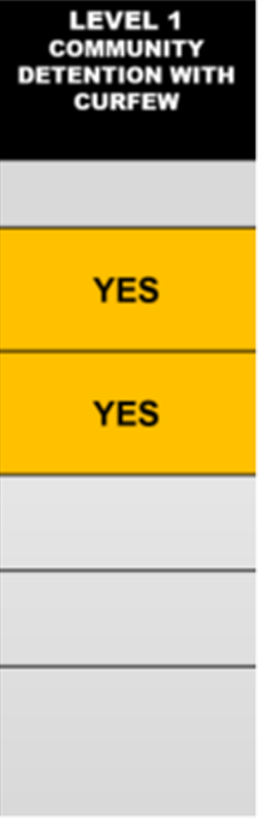
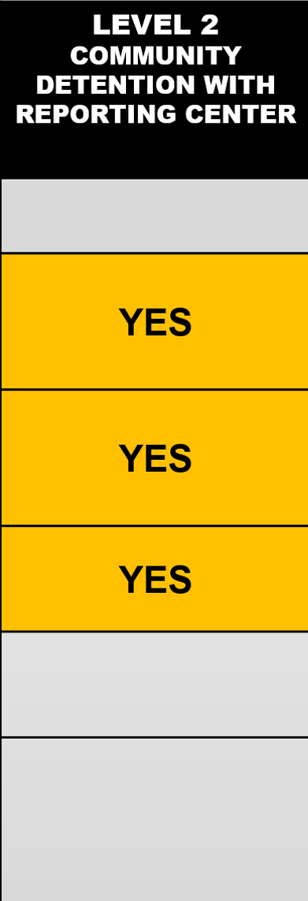
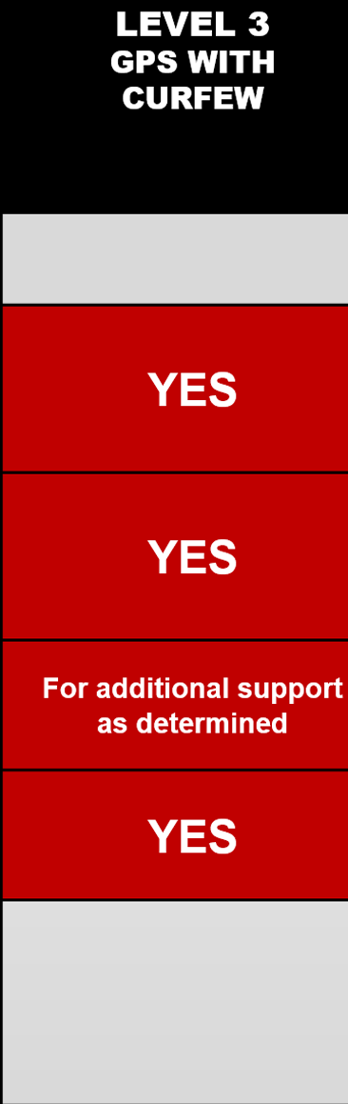
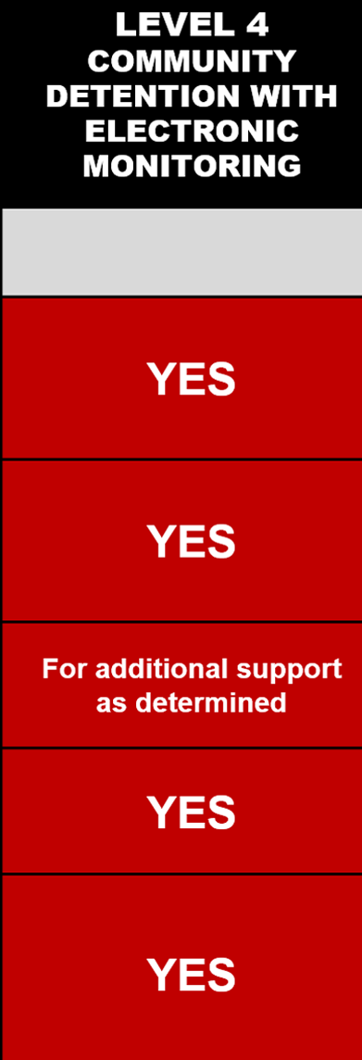
COMMUNITY DETENTION CONTINUUM
(EFFECTIVE NOVEMBER 1, 2024)
MONITORING SERVICES
DIRECT CONTACTS with SUPPORT Face-to-Face Contacts Phone Contacts (Youth and Parent)
COMMUNITY SUPPORT Home and Community Check-Ins Service Referrals
EVENING REPORTING HOURS Evening Reporting Hours: 3 pm – 9 pm
LOCATION MONITORING Use of Electronic Monitoring or GPS
TOTAL HOUSE ARREST (THA) Required to remain in assigned residence at all times, with the exception of attending school, scheduled work, and approved family events/activities
LEVEL 2
COMMUNITY DETENTION WITH EVENING REPORTING HOURS
LEVEL 4
GPS/CD WITH ELECTRONIC MONITORING
MONITORING SERVICES:
DO NOT DISTRIBUTE WITHOUT EXPLICIT PERMISSION FROM DJS
Notes:
Invite committee members to tour our CD headquarters (VS)
DJS does not use a private contractor.
Program operations are run by DJS staff and is a 24/7 operation with court notifications for infractions as well as new requirements that stemmed from HB 814 which include mandatory notification to the Court, SAO, and Child’s Counsel within 24 hours of violation for any child on pretrial electronic monitoring or GPS who violates the Community Detention agreement
Where youth are in the process (pre-adj and post-D)
Court decides when youth is released from CD
Court can modify the supervision levels at its discretion

Slide 7
Adjudication
State’s Attorney Review and Decision
State’s Attorney can elect to:
Adjudicatory Hearing
At adjudicatory hearing, the Court can elect to:
Delinquency Finding
If the Court finds the youth delinquent, the case moves to the disposition hearing where a disposition recommendation is made.
Court Decision
For youth who DJS recommends an alternative to detention or detain until court, the Court will determine whether to:
Release to community
Implement an Alternative to Detention
Detain until next court hearing.
File the petition;
Return to DJS for informal supervision; or
Refuse to file petition.
Find a youth delinquent;
Return the case to DJS for informal supervision; or
Find the youth not delinquent.
Disposition Recommendation
DJS uses the validated Maryland Comprehensive Assessment and Service Planning (MCASP) Tool to identify the youth’s strengths, risk, and needs
After DJS meets with the youth and family to complete the MCASP, DJS then makes the recommendation to the Court at the Disposition Hearing.
DO NOT DISTRIBUTE WITHOUT EXPLICIT PERMISSION FROM DJS

Slide 8
Disposition Hearing and Court Determined Placement
Disposition Hearing
For youth who are found delinquent, the Court conducts a disposition hearing
Court Determined Placement
At the Disposition Hearing, the Court can choose to place the youth:
In out of home placement
On probation through DJS
Out of Home Levels of Care*
Level 1 - Community Residential:
        Treatment Foster Care
        Group Home
        Therapeutic Group Home
        Independent Living
        Level 2 - Staff Secure Residential
  Treatment Program (DJS Operated)
  Group Home (on grounds school)
  Therapeutic Group Home (on grounds school)
  Residential Treatment Center (RTC)
  Level 3 – Hardware Secure
Treatment Program (DJS Operated)
Residential Treatment Center (RTC)
*Only the court has the authority to release a youth from treatment.*
Statutorily Mandated Probation Terms*
Misdemeanor Offenses: One (1) year, not to exceed two (2) years with extensions ordered by the Court.
Non-Violent Felony Offenses: Two (2) years, not to exceed four (4) years with extensions ordered by the Court.
Felonies: No statutory time limit up to age 21.
*Only the court has the authority to release a youth from probation.*
DO NOT DISTRIBUTE WITHOUT EXPLICIT PERMISSION FROM DJS

Slide 9


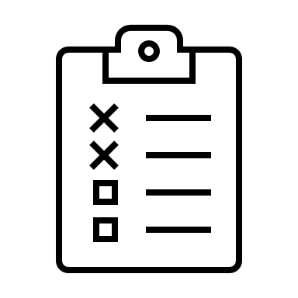

KEY HB 814 LEGISLATION
INTAKE OPERATIONS:
Changes in
Case Forwarding Requirements
LAW ENFORCEMENT PRACTICES
Changes in police handling of youth under 13 with motor vehicle theft charge
DETENTION REQUIREMENTS
Changes in placement of youth under age 13 in secure detention
ELECTRONIC MONITORING NOTIFICATION
Changes in DJS reporting of violations
Notes:
INTAKE OPERATIONS
Case Forwarding Decisions: Intake must forward a complaint to the State’s Attorney when: Proposing an informal adjustment or denying authorization to file a petition if a child is alleged to have committed:
Handgun Offenses;
All felony offenses (violent or non-violent);
Firearm Offenses; OR
Any offense if the child is under court ordered DJS supervision at the time of the alleged offense.
Case Forwarding Decisions: Intake shall forward to the SAO when there is a failed informal adjustment and intake denies authorization to file a petition.
LAW ENFORCEMENT REQUIREMENT
Under 13 Motor Vehicle Theft: law enforcement officers are required to forward complaints to DJS to file a CINS petition if officer alleges a child under 13 committed a motor vehicle theft.
DETENTION REQUIREMENTS
Detention Eligibility: A child MAY NOT be placed in detention BEFORE a hearing if the most serious offense would be a misdemeanor unless The alleged act was a handgun offense or a firearm offense
Detention for Youth Under Age 13: Child 10-12 may be detained if the alleged act would be a misdemeanor handgun or firearm offense AND the has a prior adjudication for one same listed offense (chronicity).
EM NOTIFICATIONS
If a child who has yet to be adjudicated and on pretrial electronic monitoring or GPS violates the Community Detention Agreement, DJS is required to notify the following parties within 24 hours:
Juvenile Court;
State’s Attorney’s Office; and
Child’s Counsel wwithin 24 hours.

Slide 10
Baltimore City Trainings
DJS conducted numerous trainings regarding HB 814 implementation leading up to and following November 1, 2024 including but not limited to:
The Baltimore City Juvenile Court
The State’s Attorney’s Office
The Public Defender’s Office
Baltimore Police Department
Community Stakeholders
DO NOT DISTRIBUTE WITHOUT EXPLICIT PERMISSION FROM DJS

Slide 11
DATA TRENDS
DJS Presentation:
Baltimore City Council Public Safety Committee Legislative Oversight- Crime Reduction and Violence Prevention
May 13, 2025

Slide 12
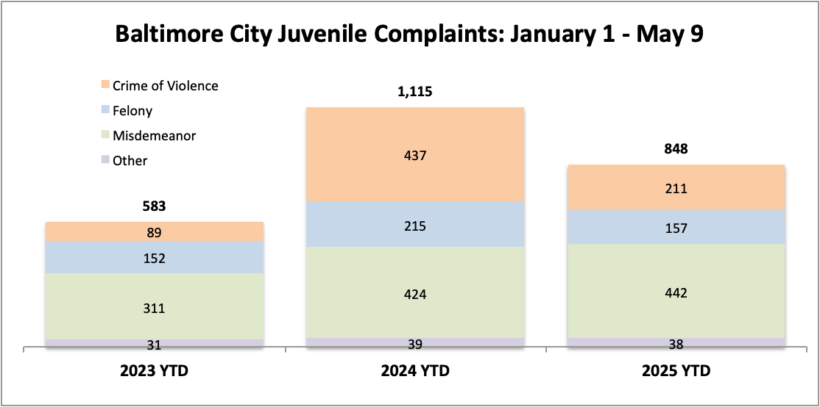
Year to date trends in the number of juvenile complaints received by DJS between 2024 and 2025 are down by nearly one-quarter
-24%
DO NOT DISTRIBUTE WITHOUT EXPLICIT PERMISSION FROM DJS

Slide 13
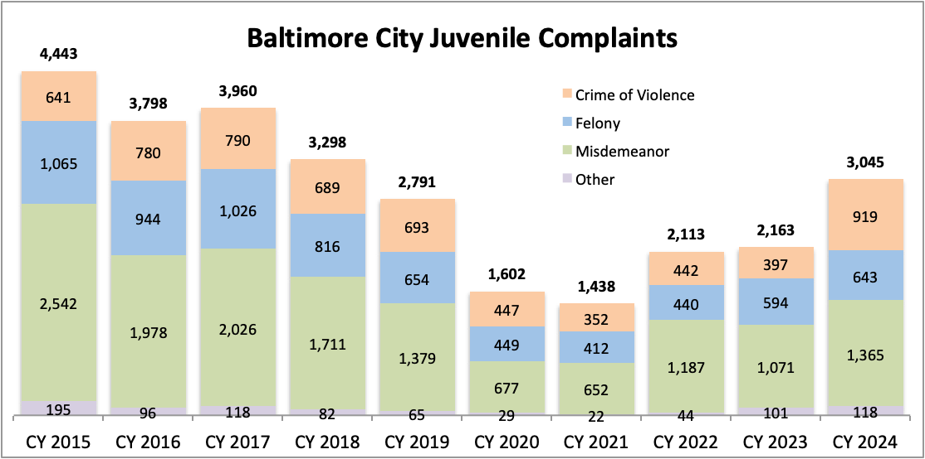
Felony and misdemeanor complaints are much lower than pre-pandemic trends, with crimes of violence trending higher.
Notes:
Talking Points:
Though rising steadily since CY 2020, juvenile complaints are still lower than pre-pandemic numbers
Current trends allow DJS to focus its custody and non-custody resources on youth who present the highest levels of risk.

Slide 14
BALTIMORE CITY
DJS INITIATIVES AND COLLABORATION
DJS Presentation:
Baltimore City Council Public Safety Committee Legislative Oversight- Crime Reduction and Violence Prevention
May 13, 2025

Slide 15
DJS COLLABORATIVE ACTIVITIES WITH BALTIMORE CITY STAKEHOLDERS:
Electronic Monitoring Headquarters Tours
Baltimore City Criminal Justice Coordinating Council
Commission on Juvenile Justice Reform and Emerging Best Practices
BPD Youth of Concern Weekly Meetings
Youth Violence Stat Participation
Mayor’s Office of Family and Child Success (MOCFS) and Office of African-American Male Achievement (MOAAMA)
Childhood Fatality Review
SPECIAL INITIATIVES
Thrive Academy
Thrive Passport
ACCESS ATD (TOJ ATD)
Probation Transformation
Community Continuum Expansion
- Workforce Development
    - MST

Slide 16
Baltimore City Outcomes
One and Done: The majority of youth referred to DJS with a complaint have no further referrals.
  Non-Detained Success Rate: Youth who were initially recommended for detention by law enforcement but were released by DJS Intake or the Court within three days show consistently high success rates
    70.5% of Baltimore City youth had no new offense or FTA within 60 days
    Probation Recidivism (for youth based on probation in FY 2022)
    70.5% of Baltimore City youth had no new sustained juvenile or adult convictions
    within one year.
    Treatment Program Recidivism (for youth released from committed treatment programs in FY 2022)
    80.4% of Baltimore City youth had no new sustained juvenile or adult convictions
    within a year.

